Slide 1

Professional Development Training
March 9–10, 2026
Charter School Leadership Training | Montgomery, Alabama
Alabama Public Charter School Commission

Slide 2
Governance
Dr. Douglas Riley, Finance Specialist
Alabama Public Charter School Commission | Professional Development Training

Slide 3
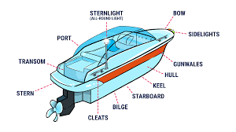
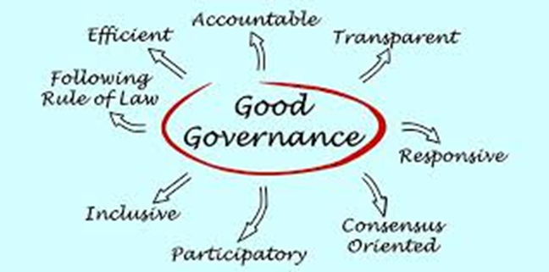
Agenda
Overview
Relevant Laws & Rules
Governing Documents
Board Member Requirements
Conducting Meetings
Duties of the Board
APCSC Oversight
Scenarios
Questions and Comments
Good Governance cannot remain merely a philosophy. Concrete steps have to be taken for realizing its goals – Narendra Modi
Alabama Public Charter School Commission | Professional Development Training

Slide 4


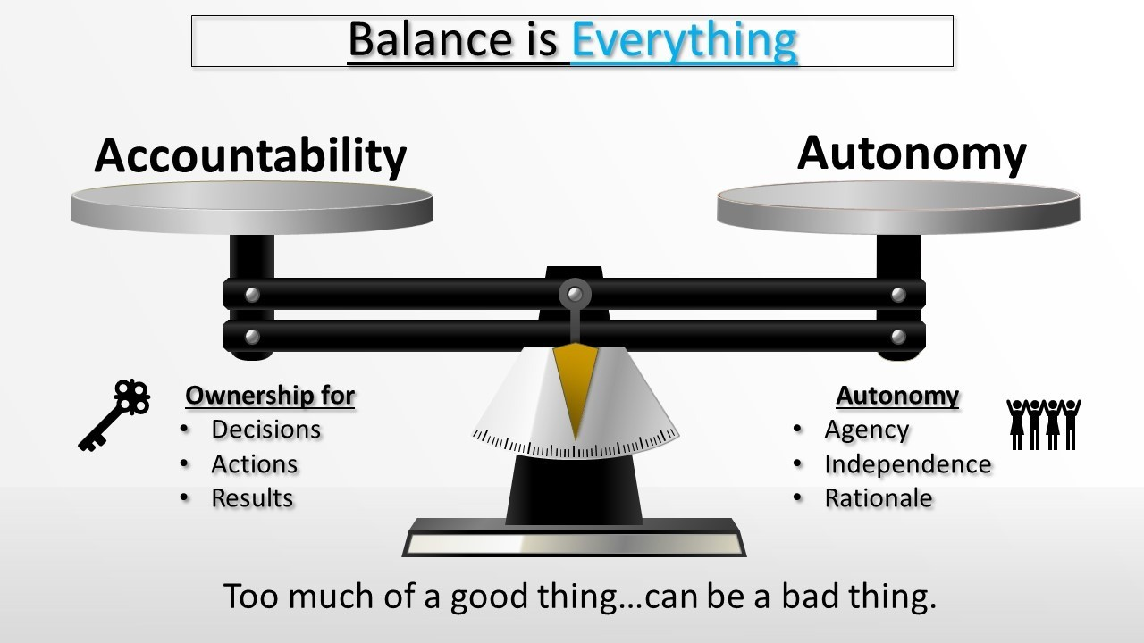
Overview
The governing board of a charter school…
  …has autonomy over key decisions including, but not limited to, decisions concerning finance, personnel, scheduling, curriculum, instruction, and procurement. Ala. Code § 16-6F-4(16)a.
The powers, obligations, and responsibilities…
… cannot be delegated or assigned…
Ala. Code § 16-6F-9(c)(5).
Governing Board
Head of School
CSFO
Alabama Public Charter School Commission | Professional Development Training

Slide 5
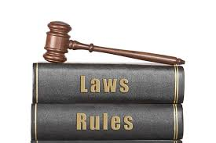

Relevant Laws & Rules
Alabama School Choice and Student Opportunity Act
School boards shall be a 501(c)3 tax-exempt organization.
Ala. Code § 16-6F-4(16)b.
Board members are subject to the State Ethics Law.
Ala. Code § 16-6F-9(a)(9).
School boards shall comply with the Open Meetings Act.
Ala. Code § 16-6F-9(d)(3).
Boards are subject to the nonprofit laws of the state.
Board members have disclosure requirements.
Boards conduct business in public.
Alabama Public Charter School Commission | Professional Development Training

Slide 6

Governing Documents
Bylaws
Name, Purpose, Principal Office
Size & Membership
Qualifications for Appointees
Roles & Responsibilities
Etc.
Charter School Contract
Performance Framework
Mission Specific Goals
APCSC Requirements
Etc.
Legal & Tax Documents
Articles of Incorporation/Certificate of Formation
501(c)3 Status notification
Other policy documents
Etc.
Alabama Public Charter School Commission | Professional Development Training

Slide 7


Board Member Requirements
Parent Representation: The Board shall have at least 20% of its membership be parents or guardians of students who attend or have attended the public charter school for at least one academic year.
Ala. Code § 16-6F-4(10).
Plus any requirements
in your…
Prohibitions: By law, no board member shall:
ESP connection Ala. Code § 16-6F-4(16)b.
Authorizer connection Ala. Code § 16-6F-4(16)b.
Financial gain Ala. Code § 36-25-5(a).
Facility usage Ala. Code § 36-25-5(d).
Solicitation Ala. Code § 36-25-5(e) & Ala. Code § 36-25-7(b).
Confidentiality Ala. Code § 36-25-8.
Statement of Economic Interest
Conflict of Interest
Disclosure Statement
Alabama Public Charter School Commission | Professional Development Training

Slide 8

Conducting Meetings
…the deliberative process of governmental bodies shall be
open to the public during meetings…
Ala. Code § 36-25A-1(a).
Notice Requirement: Public notice at least 7 days before the meeting. Ala. Code § 36-25A-3.
Location: In the LEA of the school at convenient times. Ala. Code § 16-6F-9(a)(8).
Virtual Elements: Board members appearing via Zoom trigger extra conditions.
Ala. Code § 36-25A-5.1.
Parliamentary Procedure: Quorum, agenda, minutes, voting, etc. Ala. Code § 36-25A-5.
Minutes: Record of the meeting is public. Ala. Code § 36-25A-4.
Executive Session: Can deliberate in private for a specific set of items. Ala. Code § 36-25A-7.
Alabama Public Charter School Commission | Professional Development Training

Slide 9

Duties of the Board
Hold Meetings
Financial Oversight
  Budget
  Monthly financials
  Debt
  Procurement
  Audit
Contracts
Insurance
Leadership Evaluation
Staffing
Enrollment & Recruitment
Academic Oversight
Schedule & Calendar
Alabama Public Charter School Commission | Professional Development Training

Slide 10

APCSC Oversight
An authorizer shall continually monitor the performance…
  …including collecting and analyzing data…so long as those activities…
    …do not unduly prohibit the autonomy granted to public charter schools.
                Ala. Code § 16-6F-8(b)(1).
Organizational Performance Section
I. Governing in the Public Interest
Measure | Description
Board Composition | Number, attendance, training
Mission & Vision | Board approved
Governing Documents | Bylaws public, required items
Open Meetings Act | Quorum, notice requirement, parliamentary procedure
Leadership Accountability | Head of School & CSFO
Recruitment & Enrollment | School Model Capacity
Disclosures | Submitted, SEI
Alabama Public Charter School Commission | Professional Development Training

Slide 11

Scenario #1
After a recent storm, visible leaks and inspection, ABC Charter School determines their building needs a new roof.
When discussing with the board, a member who owns a construction company states,
“My company will do the repair at cost.”
How do you proceed?
Alabama Public Charter School Commission | Professional Development Training

Slide 12

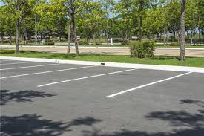
Scenario #2
A board member also serves on a board for a nonprofit that hosts an annual weekend festival art show. The board member asks to use the school parking lot for overflow parking for the festival.
How do you proceed?
Alabama Public Charter School Commission | Professional Development Training

Slide 13

Questions and Discussion
We welcome your questions and feedback.

