Slide 1

Professional Development Training
March 9–10, 2026
Charter School Leadership Training | Montgomery, Alabama
Alabama Public Charter School Commission

Slide 2
Data Review and Analysis
Alabama Public Charter School Commission | Professional Development Training

Slide 3
Purpose of Data and Analysis Thereof
To enhance decision-making and drive strategic actions, the purpose of data analysis includes:
Identify trends and patterns in data for informed insights.
Support evidence-based decision-making across various sectors.
Optimize processes and improve operational efficiency.
Predict future outcomes and behaviors using historical data.
Enhance customer understanding and tailor services accordingly.
Monitor performance metrics to ensure goals are met.
The bullets above were created utilizing AI. However, I believe data serves two primary purposes:
It does help to identify trends, patterns and outcomes that should drive future actions
It should also prompt the kind of informed questioning that leads to improved insights that result in more positive outcomes. Data use and analysis is the foundation of action research
Alabama Public Charter School Commission | Professional Development Training

Slide 4
Data Overview
Alabama Public Charter School Commission | Professional Development Training

Slide 5
Year | System Name | Grade | Subject | Enrolled | Percent Tested | Proficient Percentage | Difference From ALSDE
2024-2025 | Alabama Aerospace and Aviation | HS | Math | 53 | 100.00 | 13.21 | -10.49
2024-2025 | Alabama Aerospace and Aviation | HS | ELA | 52 | 96.15 | 36.00 | 5.77
2024-2025 | Alabama Aerospace and Aviation | HS | Science | 53 | 100.00 | 28.30 | -4.08
2024-2025 | Breakthrough Charter School | 03-08 | Math | 160 | 99.38 | 15.18 | -19.67
2024-2025 | Breakthrough Charter School | HS | Math | 23 | 104.35 | 8.33 | -15.37
2024-2025 | Breakthrough Charter School | 03-08 | ELA | 160 | 100.00 | 47.17 | -13.07
2024-2025 | Breakthrough Charter School | HS | ELA | 23 | 95.65 | 22.73 | -7.50
2024-2025 | Breakthrough Charter School | 04/08 | Science | 48 | 100.00 | 25.39 | -16.67
2024-2025 | Breakthrough Charter School | HS | Science | 23 | 104.35 | 12.50 | -19.88
2024-2025 | Covenant Academy of Mobile | 03-06 | Math | 156 | 100.00 | 14.10 | -26.03
2024-2025 | Covenant Academy of Mobile | 03-06 | ELA | 156 | 100.00 | 46.16 | -16.46
2024-2025 | Covenant Academy of Mobile | 04 | Science | 37 | 100.00 | 18.92 | -23.69
2024-2025 | i3 Academy | 03-08 | Math | 509 | 100.00 | 13.95 | -20.90
2024-2025 | i3 Academy | 03-08 | ELA | 509 | 100.00 | 42.23 | -18.02
2024-2025 | i3 Academy | 04/08 | Science | 173 | 100.00 | 20.23 | -21.83
2024-2025 | LEAD Academy | 03-08 | Math | 398 | 99.75 | 10.58 | -24.27
2024-2025 | LEAD Academy | 03-08 | ELA | 398 | 99.75 | 41.41 | -18.84
2024-2025 | LEAD Academy | 04/08 | Science | 129 | 100.00 | 17.83 | -24.23
2024-2025 | Legacy Prep | 03-07 | Math | 272 | 99.26 | 10.37 | -26.54
2024-2025 | Legacy Prep | 03-07 | ELA | 272 | 99.26 | 38.52 | -22.88
2024-2025 | Legacy Prep | 04 | Science | 65 | 100.00 | 18.46 | -24.15
2024-2025 | MAEF Public Charter Schools | 06-08 | Math | 307 | 98.04 | 1.98 | -25.54
2024-2025 | MAEF Public Charter Schools | HS | Math | 109 | 95.41 | 4.81 | -18.89
2024-2025 | MAEF Public Charter Schools | 06-08 | ELA | 307 | 98.70 | 24.84 | -31.09
2024-2025 | MAEF Public Charter Schools | HS | ELA | 109 | 90.83 | 13.13 | -17.10
2024-2025 | MAEF Public Charter Schools | 08 | Science | 101 | 98.02 | 12.12 | -29.39
2024-2025 | MAEF Public Charter Schools | HS | Science | 109 | 95.41 | 5.77 | -26.61
2024-2025 | Magic City Acceptance Academy | 06-08 | Math | 116 | 98.20 | 20.86 | -6.66
2024-2025 | Magic City Acceptance Academy | HS | Math | 48 | 100.00 | 22.92 | -0.78
2024-2025 | Magic City Acceptance Academy | 06-08 | ELA | 116 | 98.20 | 51.51 | -4.42
2024-2025 | Magic City Acceptance Academy | HS | ELA | 48 | 93.75 | 64.44 | 34.21
2024-2025 | Magic City Acceptance Academy | 08 | Science | 42 | 97.62 | 19.51 | -22.00
2024-2025 | Magic City Acceptance Academy | HS | Science | 48 | 100.00 | 54.17 | 21.79
2024-2025 | University Charter School | 03-08 | Math | 291 | 100.00 | 35.80 | 0.95
2024-2025 | University Charter School | HS | Math | 38 | 100.00 | 15.79 | -7.91
2024-2025 | University Charter School | 03-08 | ELA | 291 | 100.00 | 61.84 | 1.60
2024-2025 | University Charter School | HS | ELA | 38 | 100.00 | 57.90 | 27.67
2024-2025 | University Charter School | 04/08 | Science | 94 | 99.00 | 46.76 | 4.70
2024-2025 | University Charter School | HS | Science | 38 | 100.00 | 23.68 | -8.70

Slide 6
Correlation between % of Economically
Disadvantaged Students
and Educational Outcomes
School Type | Correlation between % Economically Disadvantaged Students and ELA Proficiency | Correlation between % Economically Disadvantaged Students and Math Proficiency | Correlation between % Economically Disadvantaged Students and Science Proficiency
All Schools | -0.558 | -0.668 | -0.749
3-8 Schools | -0.789 | -0.743 | -0.799
High Schools | -0.765 | -0.825 | -0.827
The correlation between two variables is considered to be strong if the absolute value of r is greater than 0.75. However, the definition of a “strong” correlation can vary from one field to the next. Statology
Alabama Public Charter School Commission | Professional Development Training

Slide 7
 |  | Percent Free Reduced | Academic Achievement | ELA Percent Proficient | Math Percent Proficient | Science Percent Proficient
Covenant Academy of Mobile | OK-07 | 83.77 | 57.13 | 46.15 | 14.1 | 18.92
Similar School Averages |  |  | 47.18 | 36.66 | 14.84 | 17.74
Difference |  |  | 9.95 | 9.49 | -0.74 | 1.18
ACCEL | 06-12 | 86.96 | 32.49 | 21.95 | 2.72 | 8.87
Similar School Averages |  |  | 43.16 | 29.81 | 7.61 | 13.30
Difference |  |  | -10.67 | -7.86 | -4.89 | -4.43
Legacy Prep Charter School | OK-08 | 84.23 | 47.34 | 38.52 | 10.37 | 18.46
Similar School Averages |  |  | 46.92 | 39.68 | 13.27 | 18.05
Difference |  |  | 0.42 | -1.16 | -2.90 | 0.41
LEAD Academy | PK-11 | 81.05 | 49.94 | 41.41 | 10.58 | 17.83
Similar School Averages |  |  | 49.25 | 41.50 | 14.88 | 21.27
Difference |  |  | 0.69 | -0.09 | -4.30 | -3.44
Empower Community School | OK-08 | 78.67 | 40.48 | 32.9 | 2.16 | 21.25
Similar School Averages |  |  | 51.11 | 41.50 | 16.98 | 21.27
Difference |  |  | -10.63 | -8.60 | -14.82 | -0.02
i3 Academy | OK-08 | 76.27 | 52.36 | 42.24 | 13.95 | 20.23
Similar School Averages |  |  | 54.38 | 41.56 | 18.04 | 21.99
Difference |  |  | -2.02 | 0.68 | -4.09 | -1.76
Alabama Aerospace and Aviation High School | 09-12 | 63.7 | 39.8 | 36.73 | 13.21 | 28.3
Similar School Averages |  |  | 42.3 | 28.17 | 21.72 | 30.17
Difference |  |  | -2.5 | 8.56 | -8.51 | -1.87
Magic City Acceptance Academy | 06-12 | 56.68 | 59.52 | 55.06 | 20.37 | 38.2
Similar School Averages |  |  | 54.55 | 49.06 | 24.60 | 35.48
Difference |  |  | 4.97 | 6.00 | -4.23 | 2.72
University Charter School | K-12 | 47.24 | 69.71 | 61.7 | 33.74 | 40.46
Similar School Averages |  |  | 68.52 | 59.68 | 37.70 | 38.11
Difference |  |  | 1.19 | 2.02 | -3.96 | 2.35
Breakthrough Charter School | PK-12 | 74.65 | 51.38 | 45.05 | 14.21 | 20.83
Similar School Averages |  |  | 53.69 | 45.67 | 21.70 | 24.94
Difference |  |  | -2.31 | -0.62 | -7.49 | -4.11
Floretta B Carson | 06-11 | 75.65 | 61.99 | 56.38 | 16.11 | 40
Similar School Averages |  |  | 52.94 | 37.78 | 15.15 | 24.41
Difference |  |  | 9.05 | 18.60 | 0.96 | 15.59

Slide 8
Outcome Progression/Regression
Alabama Public Charter School Commission | Professional Development Training

Slide 9
Statewide Proficiency Loss By Grad Span
Grade Span | Math | ELA
3 to 11 | -21.8 | -34.5
6 to 11 | -15.6 | -36.6
3 to 6 | -11.5 | -8.3
3 to 8 | -21 | -10.6
Grade | School | Math |  | ELA |  | Retention
 | ALA
3 |  | 45.5 |  | 64.7
4 |  | 41.8 | -3.7 | 60.3 | -4.4
5 |  | 39.3 | -2.5 | 66.8 | 6.5
6 |  | 34 | -5.3 | 56.4 | -10.4
7 |  | 24.1 | -9.9 | 56.1 | -0.3
8 |  | 24.5 | 0.4 | 54.1 | -2
11 |  | 23.7 | -0.8 | 30.2 | -23.9
 |  | -21.8 |  | -34.5
 | ACCEL |  |  |  |  | 69%
6 |  | 3.9 |  | 20.6
7 |  | 1 | -2.9 | 26.5 | 5.9
8 |  | 1 | 0 | 27.3 | 0.8
11 |  | 4.8 | 3.8 | 13.1 | -14.2
 |  | 0.9 |  | -7.5 | -7.5
 | AA and A |  |  |  |  | 62%
11 |  | 13.2 |  | 36
 | Breakthrough |  |  |  |  | 80%
3 |  | 17.6 |  | 64.7
4 |  | 26.1 | 8.5 | 56.5 | -8.2
5 |  | 11.5 | -14.6 | 51.9 | -4.6
6 |  | 11.1 | -0.4 | 44.4 | -7.5
7 |  | 16.7 | 5.6 | 37.5 | -6.9
8 |  | 8 | -8.7 | 28 | -9.5
11 |  | 8.3 | 0.3 | 22.7 | -5.3
 |  | -9.3 |  | -42
 | Covenant |  |  |  |  | 72%
3 |  | 13.2 |  | 38.6
4 |  | 5.4 | -7.8 | 54.1 | 15.5
5 |  | 15.2 | 9.8 | 54.5 | 0.4
6 |  | 21.4 | 6.2 | 40.5 | -14
 |  | 8.2 |  | 1.9
Grade | School | Math |  | ELA |  | Retention
 | I3 |  |  |  |  | 81%
3 |  | 24.6 |  | 53.6
4 |  | 26.4 | 1.8 | 45.8 | -7.8
5 |  | 11 | -15.4 | 39.7 | -6.1
6 |  | 7.7 | -3.3 | 36.3 | -3.4
7 |  | 11.7 | 4 | 42.7 | 6.4
8 |  | 7.9 | -3.8 | 38.6 | -4.1
 |  | -16.7 |  | -15
 | LEAD |  |  |  |  | 76%
3 |  | 30.9 |  | 45.7
4 |  | 9.3 | -21.6 | 34.7 | -11
5 |  | 5 | -4.3 | 43.8 | 9.1
6 |  | 0 | -5 | 27 | -16.8
7 |  | 2.3 | 2.3 | 47.7 | 20.7
8 |  | 9.3 | 7 | 51.9 | 4.2
 |  | -21.6 |  | 6.2
 | Legacy |  |  |  |  | 74%
3 |  | 22 |  | 47.5
 | Magic City |  |  |  |  | 75%
6 |  | 40.6 |  | 53.1
7 |  | 19.5 | -21.1 | 56.1 | 3
8 |  | 2.4 | -17.1 | 43.9 | -12.2
11 |  | 22.9 | 20.5 | 64.4 | 20.5
 |  | -17.7 |  | 11.3
 | University |  |  |  |  | 91%
3 |  | 38.5 |  | 61.5
4 |  | 50 | 11.5 | 72 | 10.5
5 |  | 36 | -14 | 74 | 2
6 |  | 36.2 | 0.2 | 48.9 | -25.1
7 |  | 29.2 | -7 | 64.6 | 15.7
8 |  | 25 | -4.2 | 50 | -14.6
11 |  | 15.8 | -9.2 | 57.9 | 7.9
 |  | -22.7 |  | -3.6

Slide 10
Impact of Retention
Alabama Public Charter School Commission | Professional Development Training

Slide 11
School | Year | % Returned Following Year | Average % Returned Following Year | Achievement
AAAHS | 2023 | 66%
 | 2024 | 56%
 | 2025 | 64% | 62% | 39.8
ACCEL | 2023 | 68%
 | 2024 | 67%
 | 2025 | 71% | 69% | 32.49
Breakthrough | 2023 | 79%
 | 2024 | 81%
 | 2025 | 80% | 80% | 51.38
Carson | 2025 | 67% |  | 61.99
Covenant | 2024 | 67%
 | 2025 | 76% | 72% | 57.13
Empower | 2023 | 80%
 | 2024 | 78%
 | 2025 | 76% | 78% | 40.48
I3 | 2023 | 80%
 | 2024 | 82%
 | 2025 | 81% | 81% | 52.36
LEAD | 2023 | 74%
 | 2024 | 75%
 | 2025 | 78% | 76% | 49.94
Legacy | 2023 | 71%
 | 2024 | 80%
 | 2025 | 70% | 74% | 47.34
Magic City | 2023 | 70%
 | 2024 | 78%
 | 2025 | 77% | 75% | 59.52
University | 2023 | 89%
 | 2024 | 90%
 | 2025 | 93% | 91% | 69.71
Correlation
62% | 39.8
69% | 32.49
80% | 51.38
72% | 57.13
78% | 45.48
81% | 52.36
76% | 49.94
74% | 47.34
75% | 59.52
91% | 69.71
 | 0.75

Slide 12
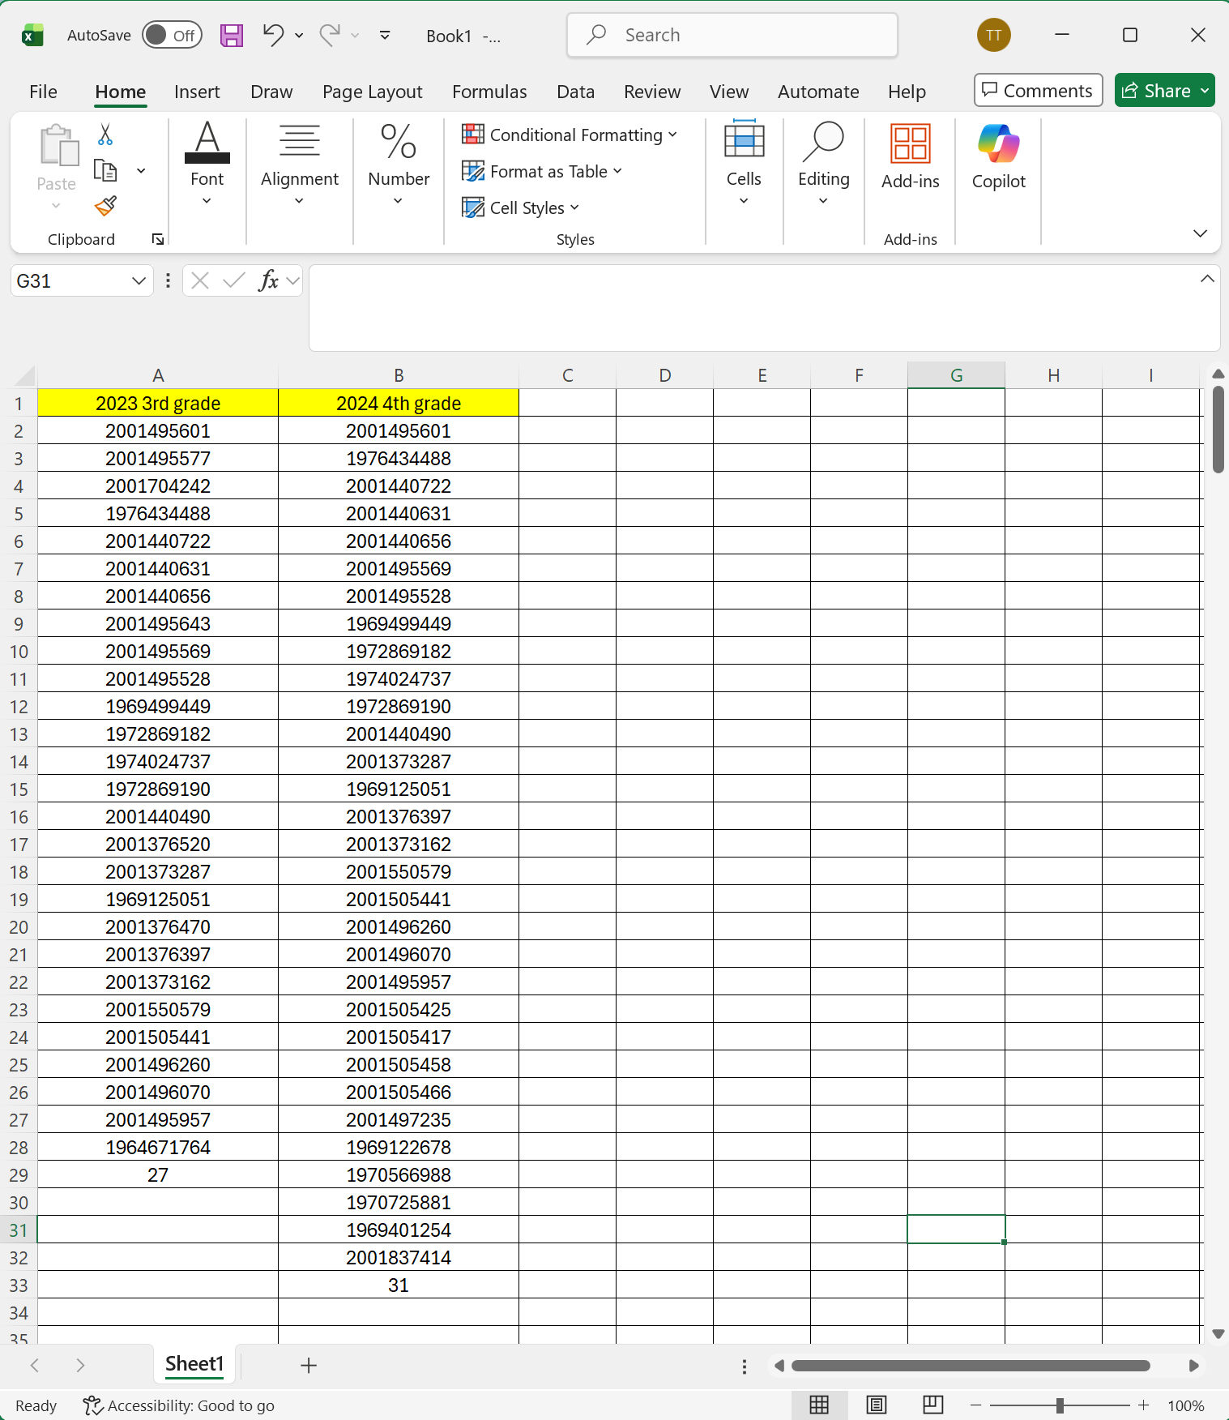
Retention (1 of 5)
It is important to utilize unique student identifiers in this process.
Make sure that you eliminate terminal grade students from the first year and initial year students from the second year.
Alabama Public Charter School Commission | Professional Development Training

Slide 13
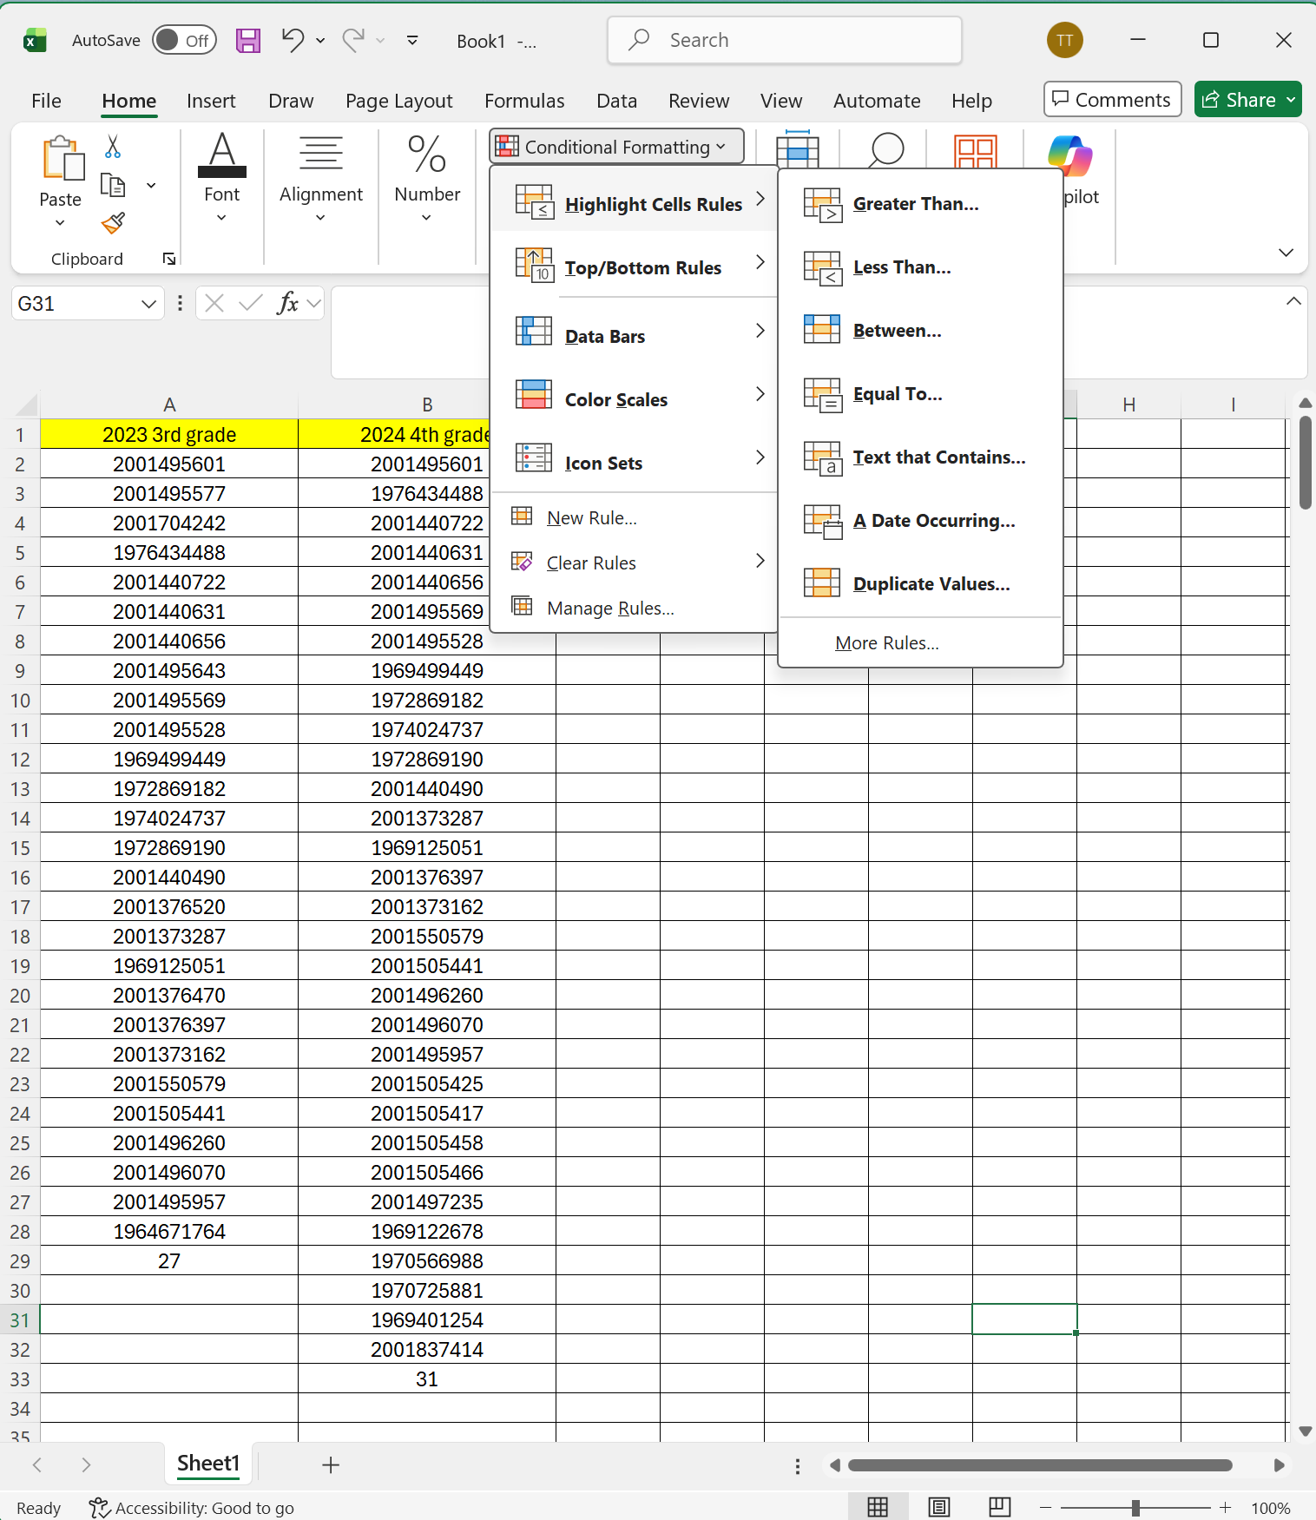
Retention (2 of 5)
Click Conditional Formatting
Hover over Highlight Cell Rules
Choose Duplicate Values
Alabama Public Charter School Commission | Professional Development Training

Slide 14
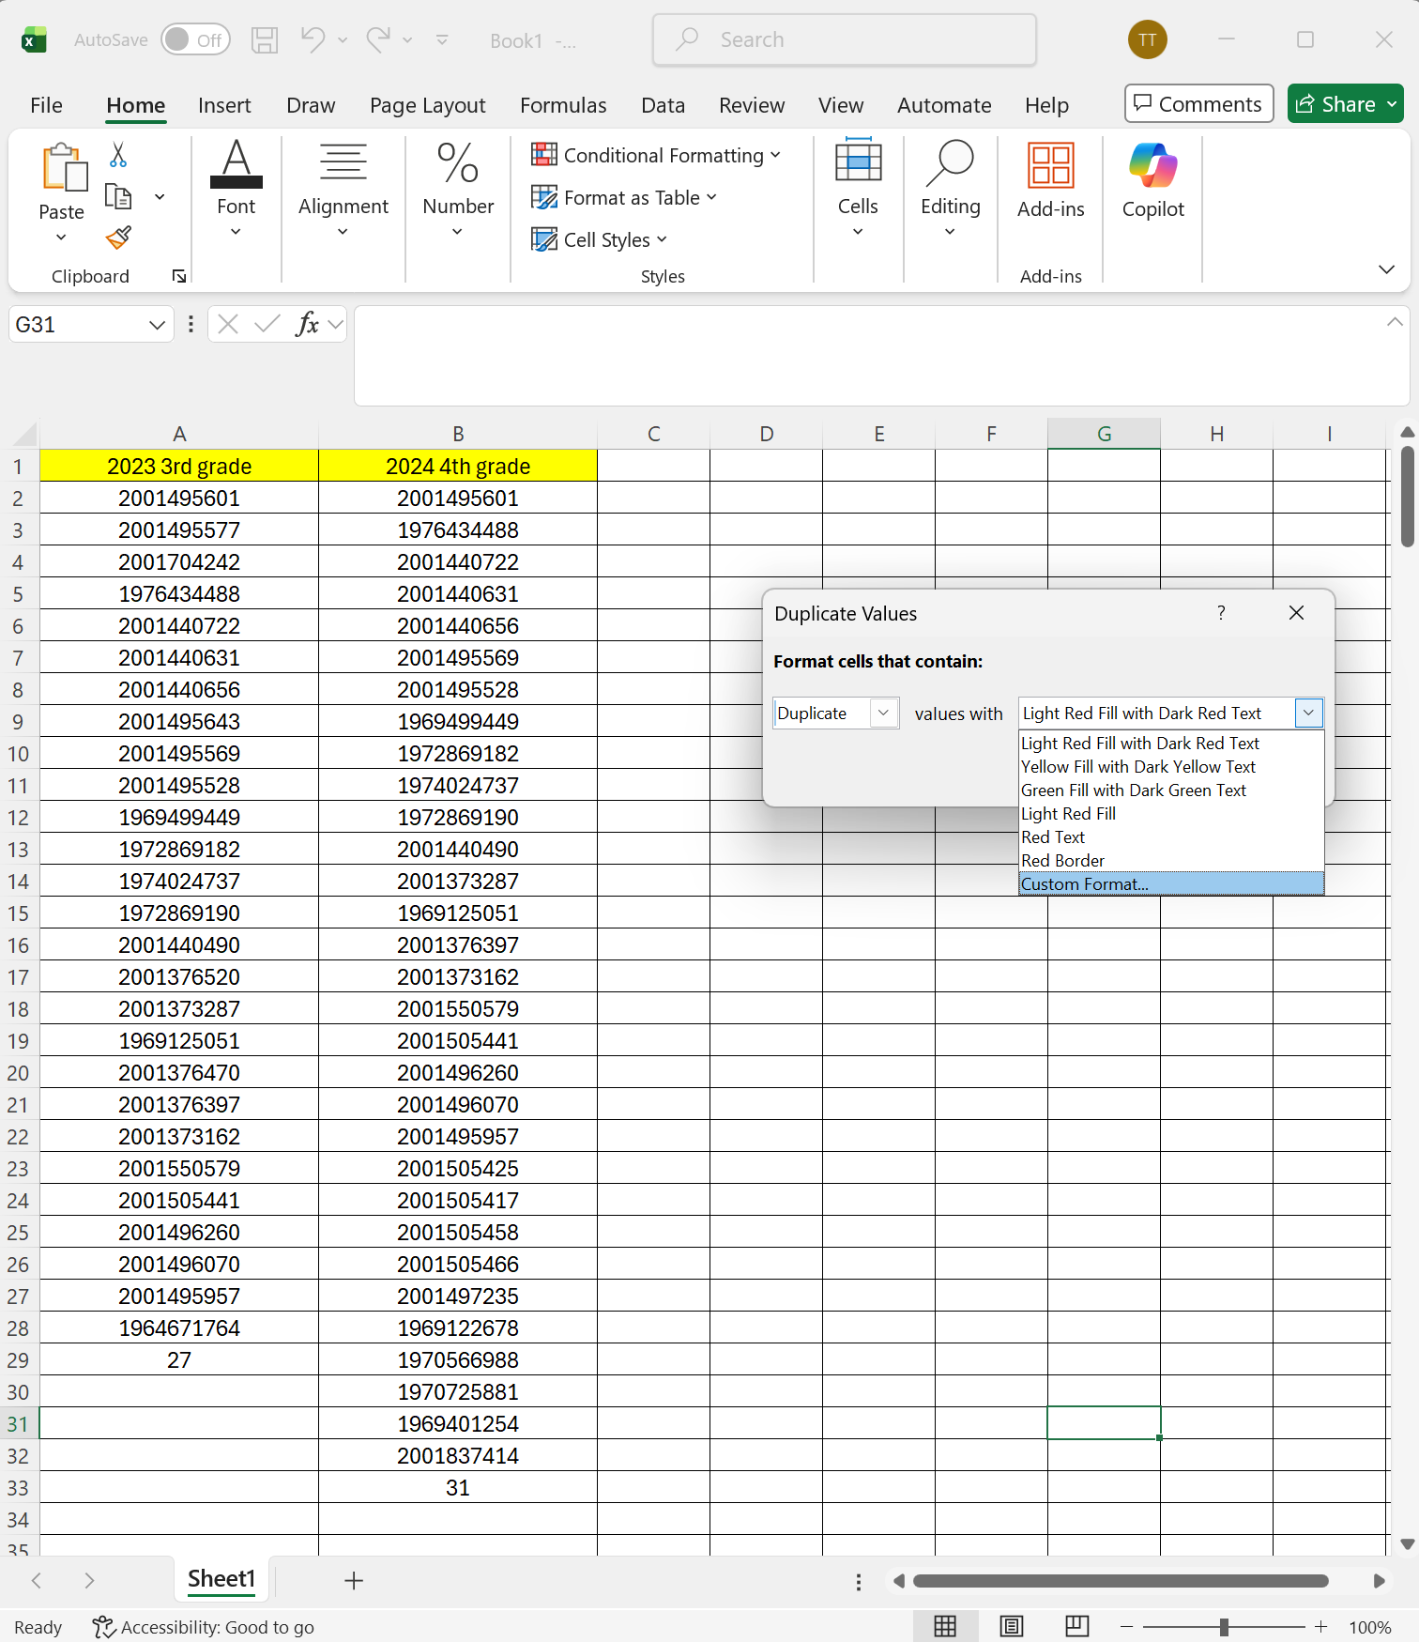
Retention (3 of 5)
Hit the down arrow and choose Custom Format
Alabama Public Charter School Commission | Professional Development Training

Slide 15
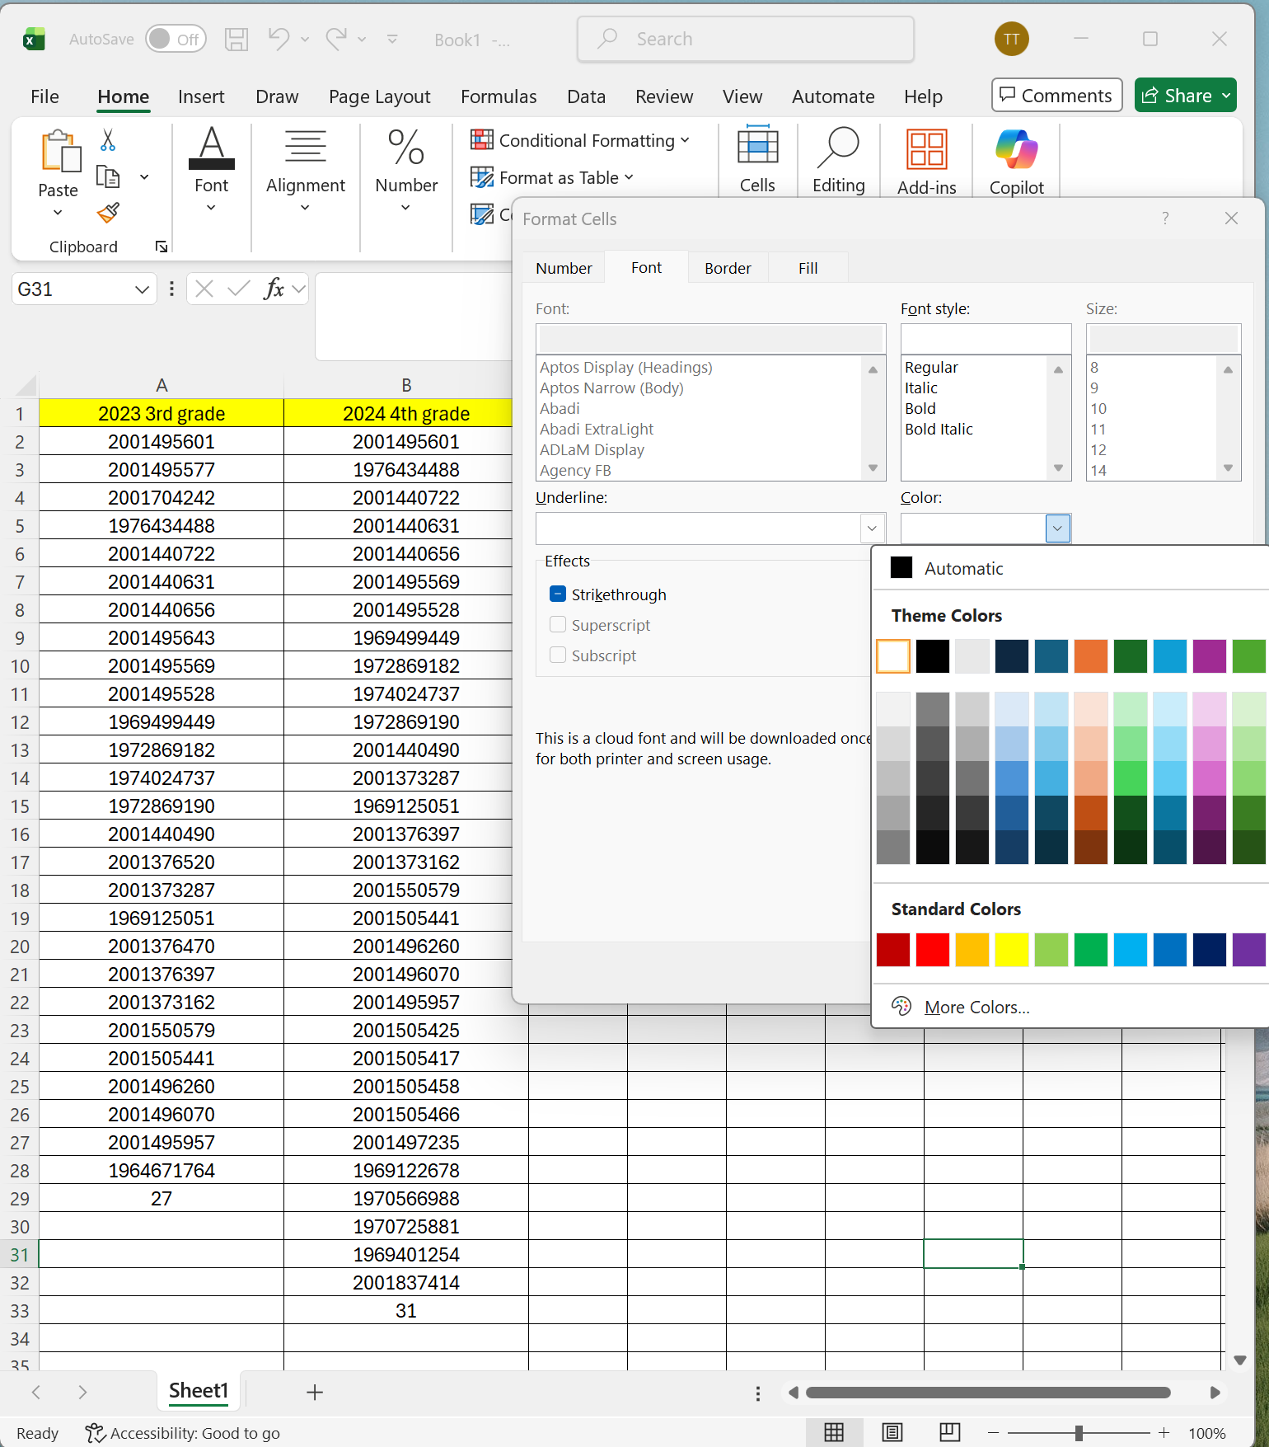
Retention (4 of 5)
Under Color choose white
Alabama Public Charter School Commission | Professional Development Training

Slide 16
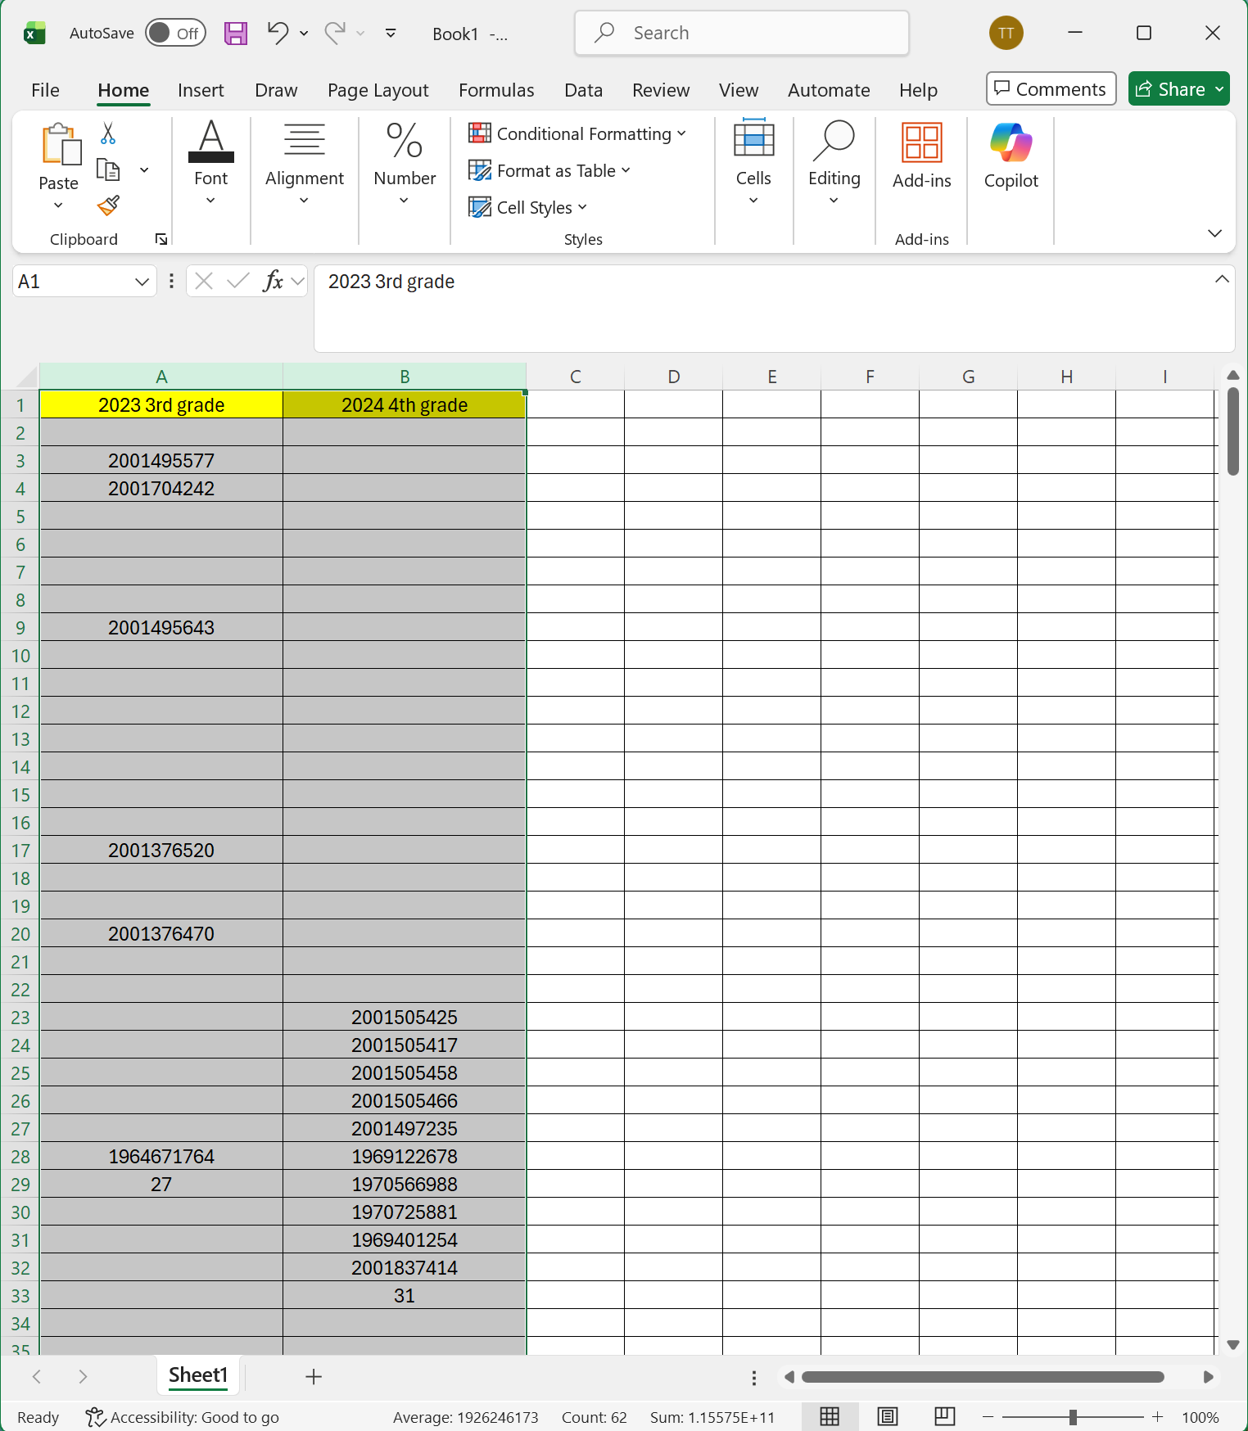
Retention (5 of 5)
All of the duplicate entries will no longer be seen.
In the example to the left, 6 of 27 third graders (22.2%) did not return for fourth grade.
Alabama Public Charter School Commission | Professional Development Training

Slide 17
Linear Regression
Alabama Public Charter School Commission | Professional Development Training

Slide 18
What is Multiple Regression?
Multiple regression is a statistical technique used to analyze the relationship between a dependent variable and multiple independent variables. Its primary purpose is to predict the behavior of the dependent variable based on the corresponding independent variables.
Assumption of Linearity: Multiple regression assumes a linear relationship between predictors and the outcome, which may not always hold true.
Regression analysis tends to perform best when large data sets are available.. Data anomalies are amplified in smaller data sets.
Heteroscedasticity-
Residuals are the differences between observed and predicted values in a regression model.
They indicate how well the model fits the data; smaller residuals suggest a better fit.
Residual plots can reveal issues like non-linearity or heteroscedasticity in the data.
Alabama Public Charter School Commission | Professional Development Training

Slide 19
Simplifying Complex Analysis
Alabama Public Charter School Commission | Professional Development Training

Slide 20
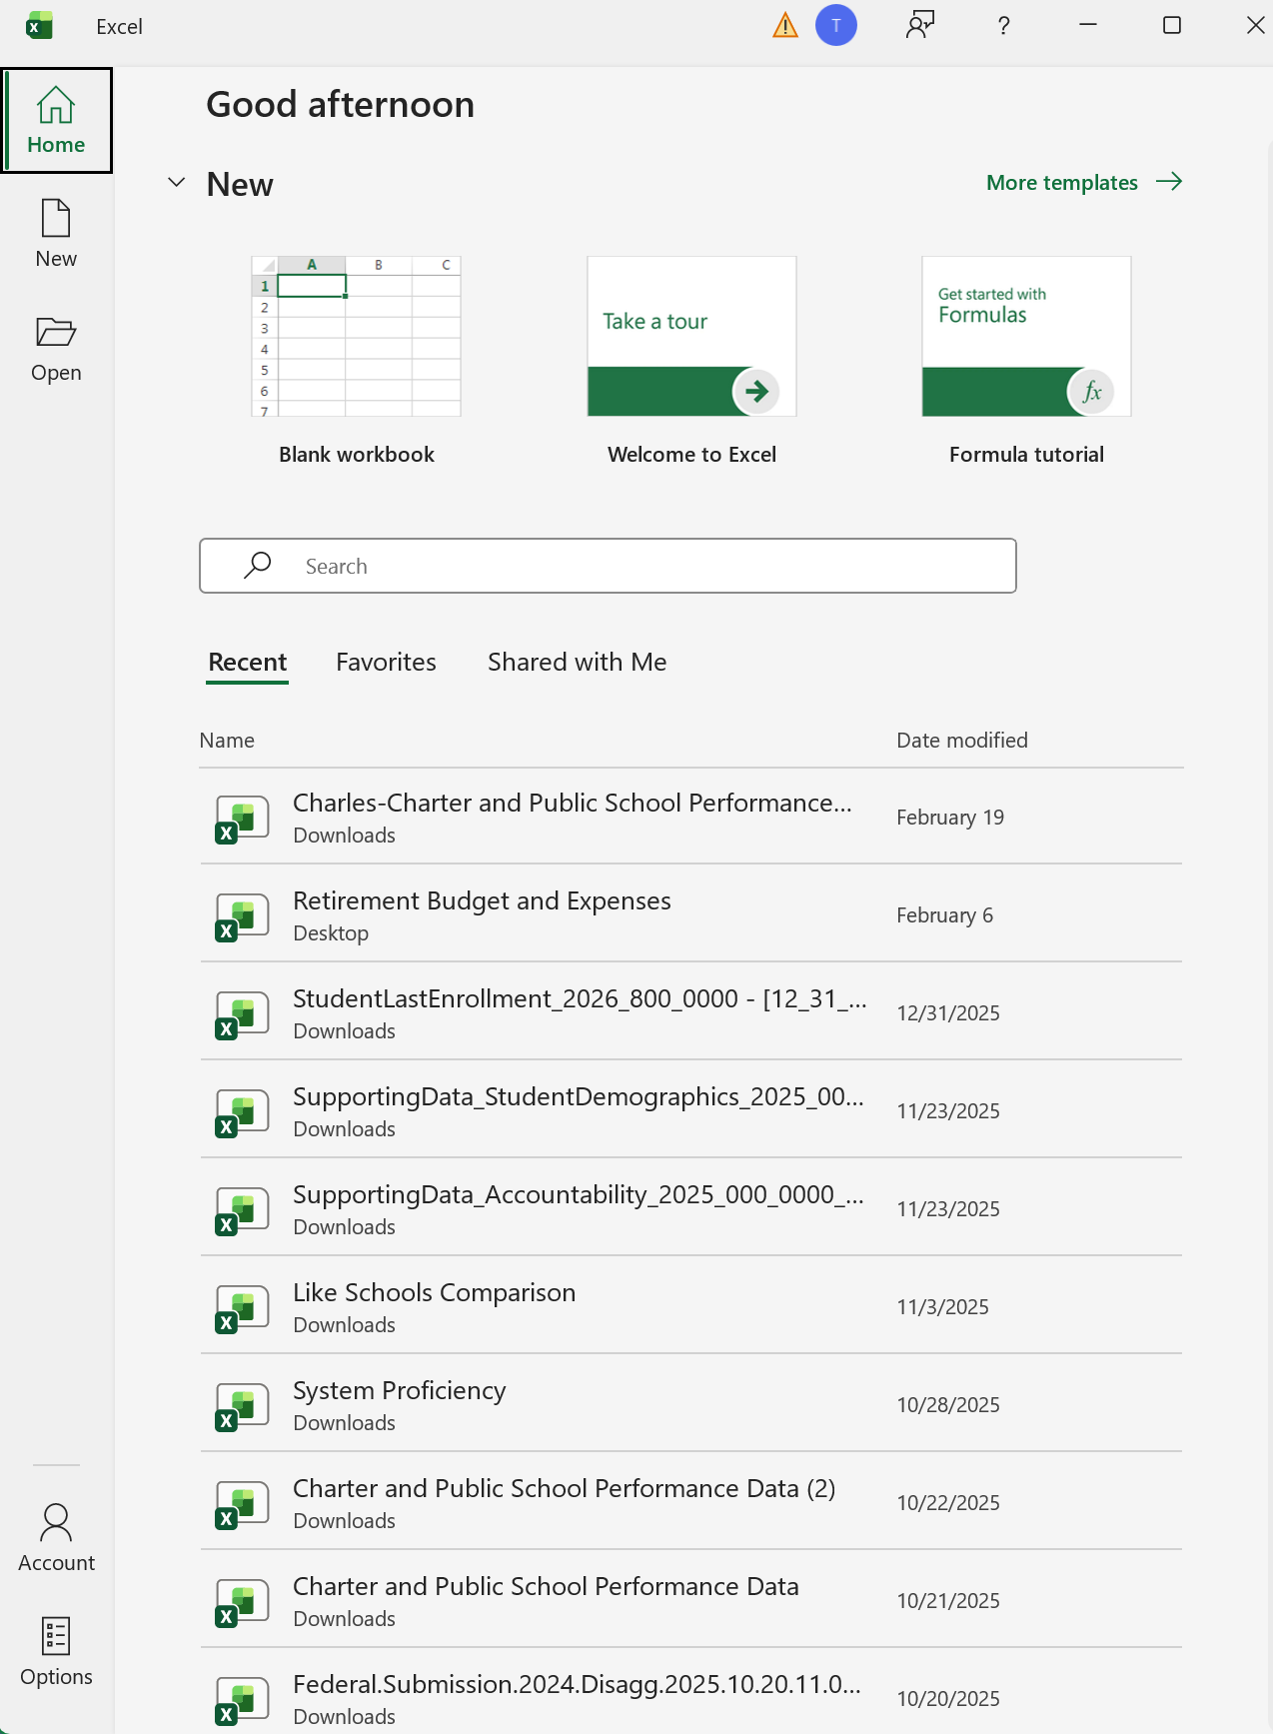
How to Activate the Data Analysis Tab
By default, the Data tab in Excel does not include the Data Analysis ribbon. To activate it, follow these steps:
Go to File and select Options.
Alabama Public Charter School Commission | Professional Development Training

Slide 21
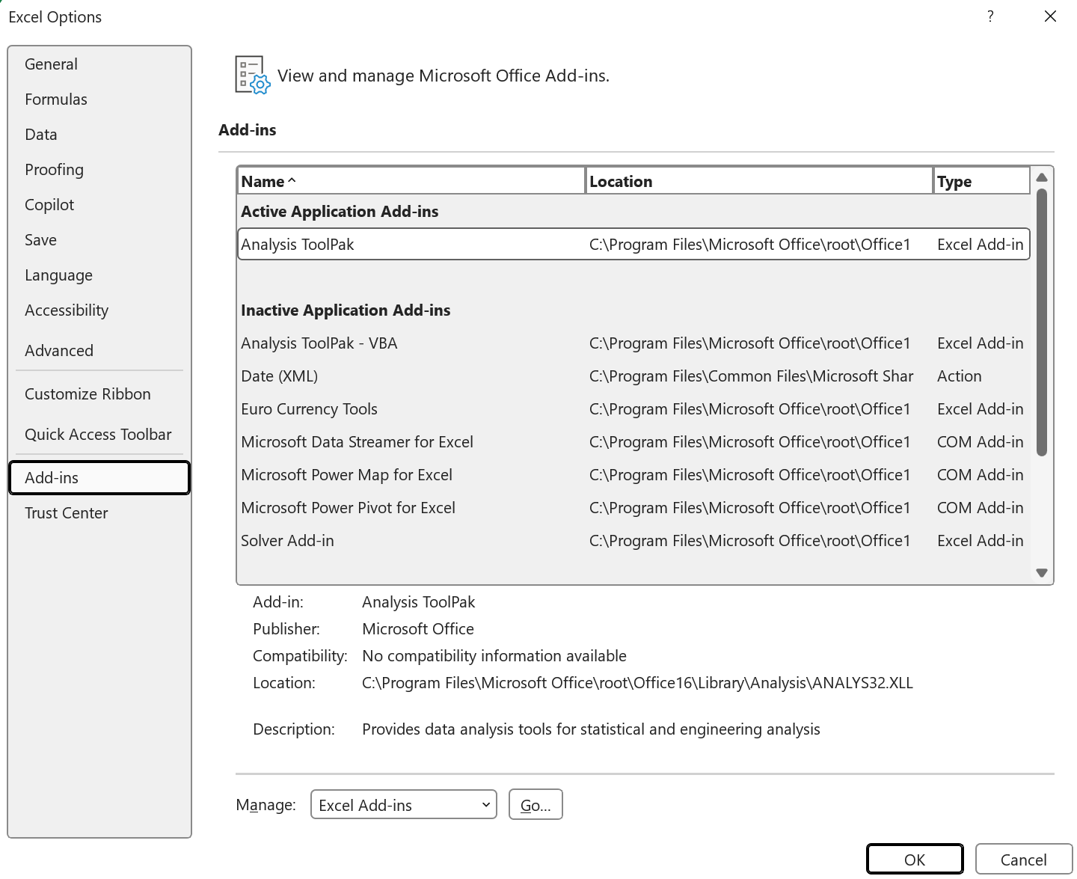
Select Add-ins.
Click on Excel Add-ins and then click Go.
Alabama Public Charter School Commission | Professional Development Training

Slide 22
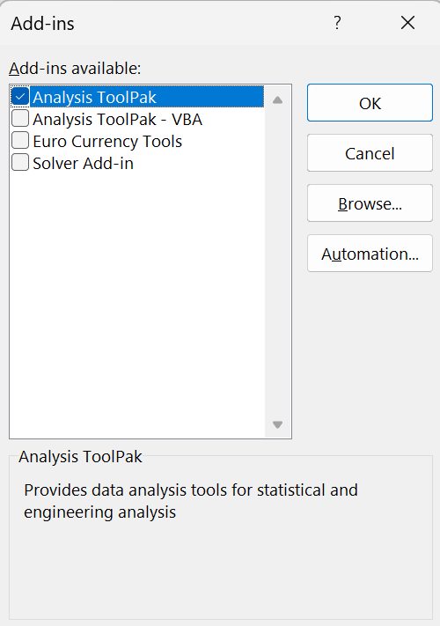
In the Add-ins available: section, check Analysis ToolPak.
Click OK.
Alabama Public Charter School Commission | Professional Development Training

Slide 23
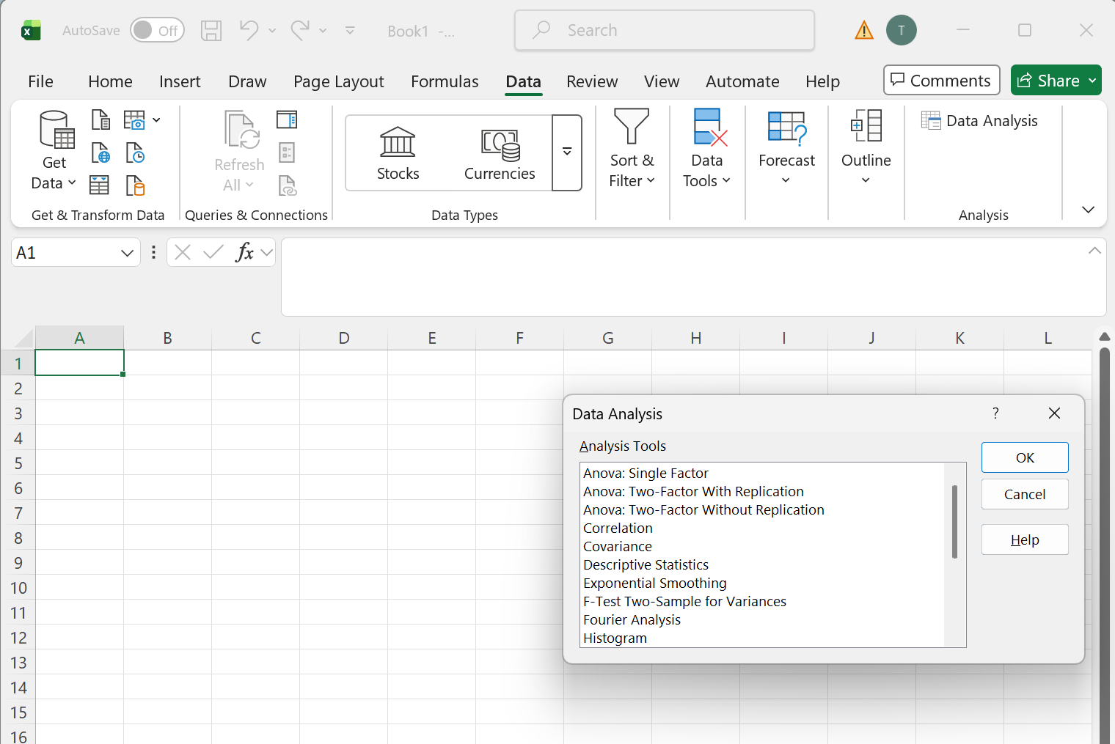
Slide title
The Data Analysis feature will appear in the Data tab.
Alabama Public Charter School Commission | Professional Development Training

Slide 24

Questions and Discussion
We welcome your questions and feedback.

