Slide 1

Professional Development Training
March 9–10, 2026
Charter School Leadership Training | Montgomery, Alabama
Alabama Public Charter School Commission

Slide 2
Community Engagement and Recruitment
Alabama Public Charter School Commission | Professional Development Training

Slide 3

Why Community Engagement Matters
Builds trust and credibility
Strengthens enrollment pipelines
Increases family advocacy and retention
Alabama Public Charter School Commission | Professional Development Training

Slide 4

Two-Way Communication
Host structured forums and town halls
- Use surveys to gather stakeholder input
- Share actions taken based on feedback
Alabama Public Charter School Commission | Professional Development Training

Slide 5
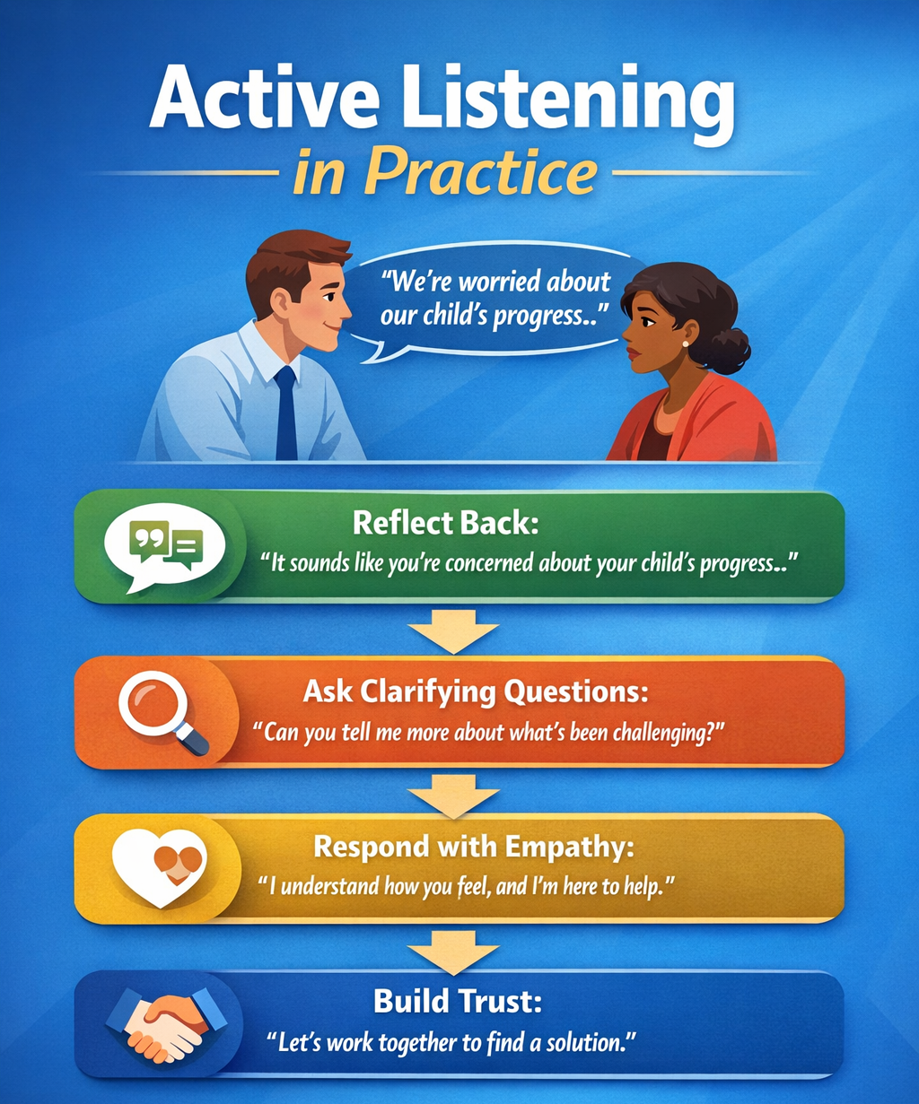
Active Listening in Practice
Reflect and validate stakeholder concerns
- Ask clarifying questions before responding
- Demonstrate empathy and transparency
Alabama Public Charter School Commission | Professional Development Training

Slide 6
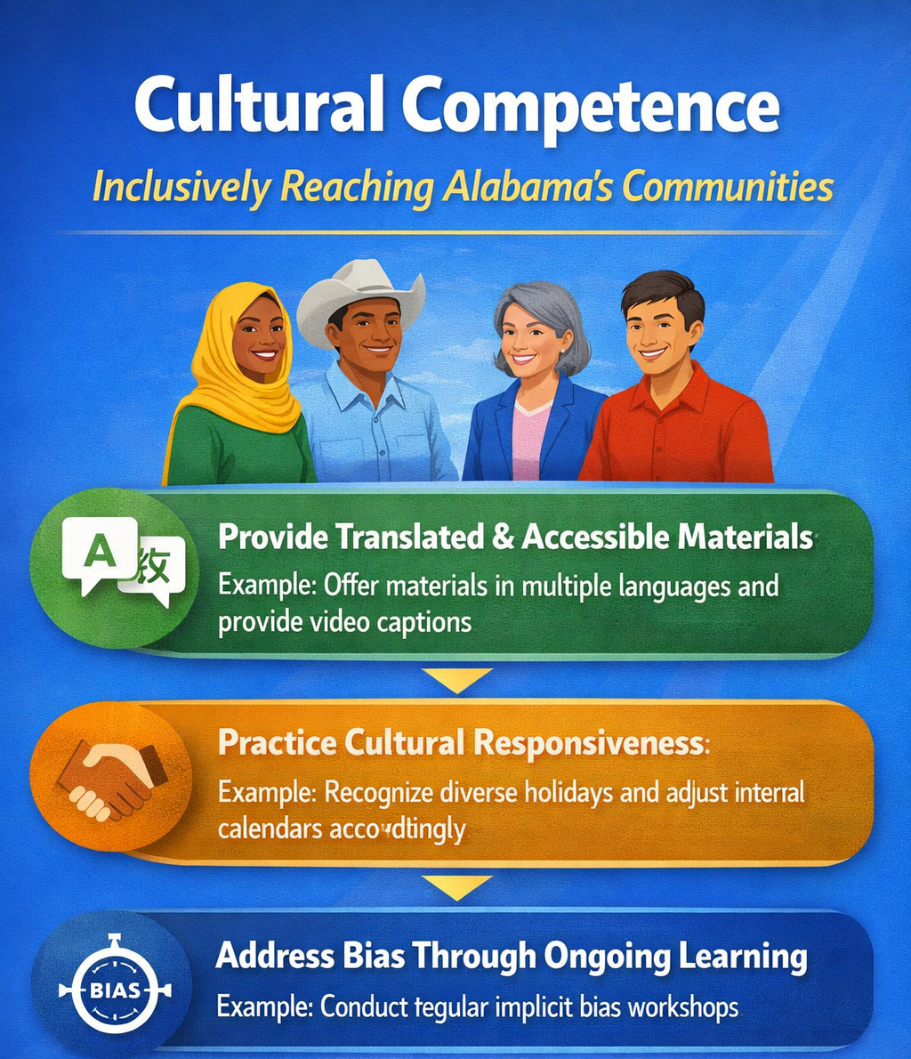
Cultural Competence
Provide accessible and translated materials
- Respect diverse backgrounds and traditions
- Invest in ongoing bias and equity training
Alabama Public Charter School Commission | Professional Development Training

Slide 7

Strategic Recruitment Planning
Identify target communities
- Develop clear value propositions
- Align messaging with community needs
Alabama Public Charter School Commission | Professional Development Training

Slide 8

Community Partnerships
Partner with local nonprofits and other organizations
- Engage Community leaders as ambassadors
- Collaborate with childcare centers
Alabama Public Charter School Commission | Professional Development Training

Slide 9
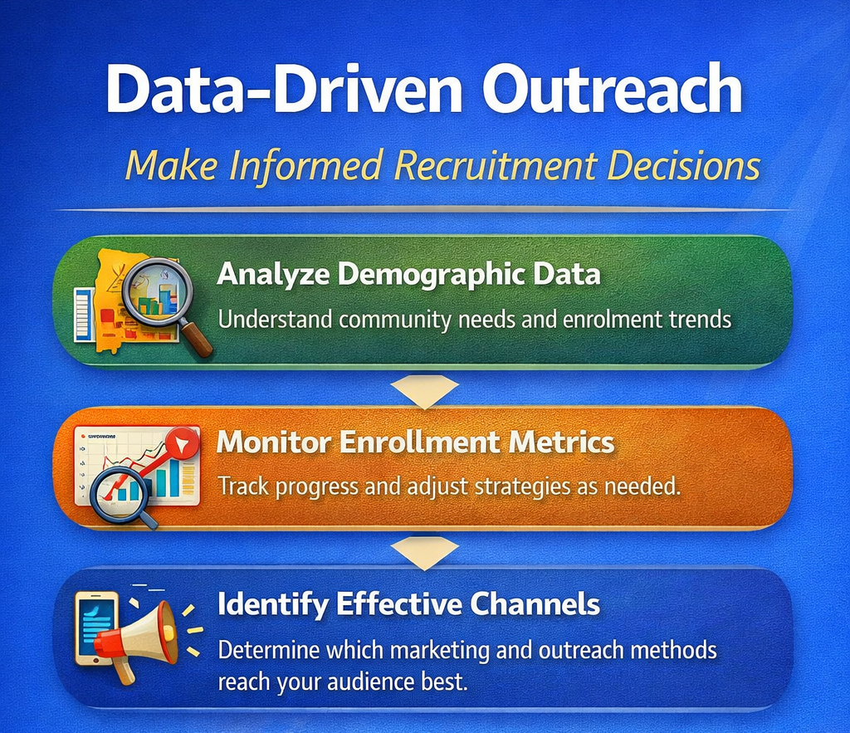
Data-Driven Outreach
Track enrollment trends and demographics
- Adjust strategies based on participation data
- Monitor retention and satisfaction metrics
Alabama Public Charter School Commission | Professional Development Training

Slide 10
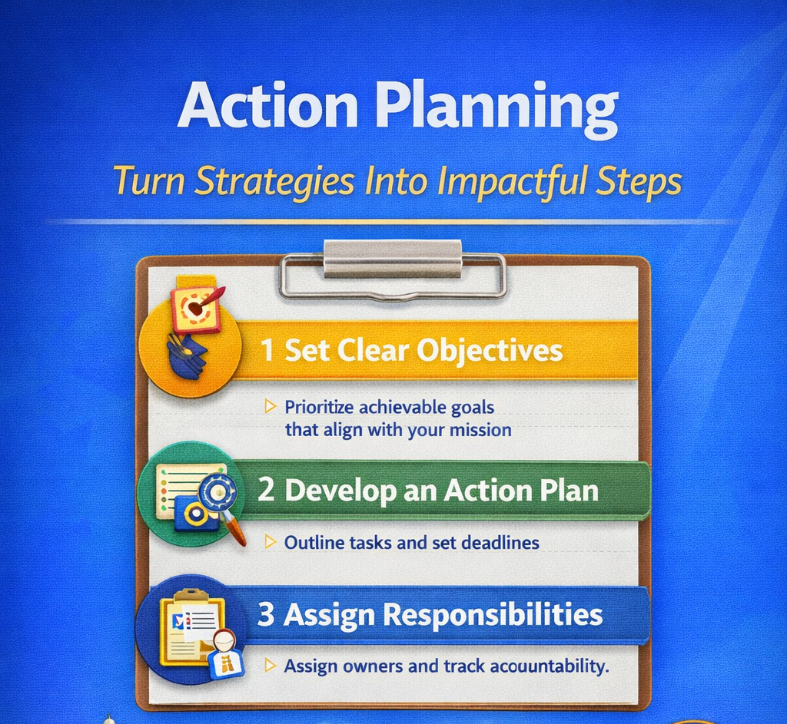
Action Planning
Identify 2-3 engagement priorities
- Assign leadership accountability
- Set measurable recruitment goals
Alabama Public Charter School Commission | Professional Development Training

Slide 11

Questions and Discussion
We welcome your questions and feedback.

