Slide 1

Professional Development Training
March 9–10, 2026
Charter School Leadership Training | Montgomery, Alabama
Alabama Public Charter School Commission

Slide 2
The CSP Subgrant Roadmap: From Application to Implementation
Jane Whitaker Ivey, CSP Project Director
Alabama Public Charter School Commission | Professional Development Training

Slide 3
Purpose of Today’s Session
Overview of the Alabama CSP Subgrant
Walk through application components
Allowable Vs. Unallowable Costs
Deep dive into the budget template
Common mistakes to avoid
Review timeline & next steps
Alabama Public Charter School Commission | Professional Development Training
Notes:
This session is designed to help you submit a strong, complete, and competitive application.

Slide 4
What is the CSP Grant?
Federal grant program authorized under the Elementary and Secondary Education Act (ESEA), Title IV, Part C
Designed to support the newly approved charter schools, expansion, conversion, and/or replication of high-quality public charter schools
Focuses on increasing access to high-quality educational options, especially for traditionally underserved students
Funds are time-limited and intended for planning, program design, and initial implementation
Alabama Public Charter School Commission | Professional Development Training

Slide 5
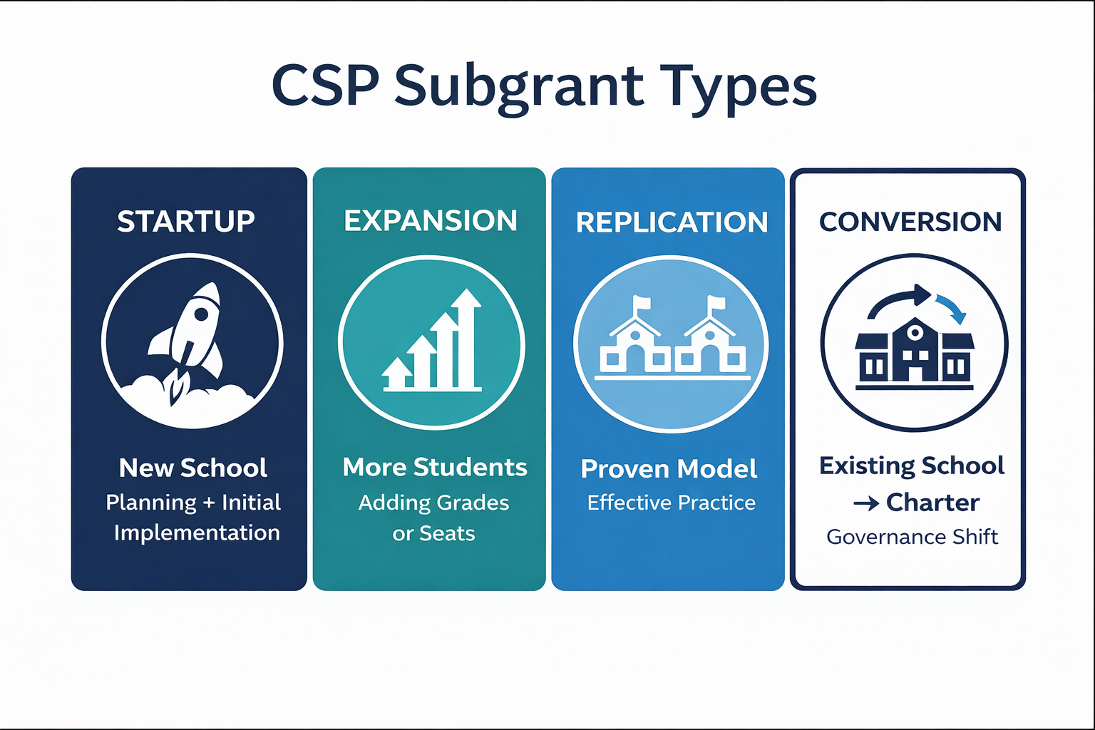
Alabama Public Charter School Commission | Professional Development Training
Notes:
Startup
Supports brand-new charter schools that have not yet opened. Funds planning year and early implementation. Time-limited launch support.
Expansion
For existing high-quality charter schools. Adding grades or increasing enrollment. Growth must not already be implemented.
Replication
Opening a new campus based on a proven, high-quality school model. Requires demonstrated success and strong outcomes.
Conversion
Traditional public school becoming a charter school. Must adopt charter governance and meet federal charter definition.

Slide 6
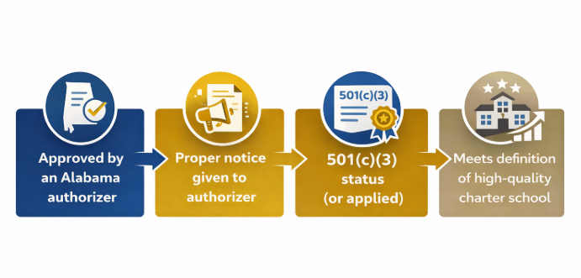
Who Can Apply?
**Expansion and Replication Only**
All Applicants must have a completed
Letter of Intent Form
Alabama Public Charter School Commission | Professional Development Training
Notes:
LOI is posted on our website for each round. This march application LOI deadline has already passed, but we plan to run an additional round in the summer so be on the lookout for future competitions.

Slide 7
Application Components
Program Description & Mission
Proposed Activities & Performance Measures
Governance & Autonomy
Budget and Sustainability
Recruitment, Enrollment, and Student Supports
Startup/Conversion OR High-Quality section depending on application type
Alabama Public Charter School Commission | Professional Development Training
Notes:
This slide outlines the major sections of the application, and I really encourage you to think of this as a connected story — not separate sections completed in isolation.
The first section is Program Description and Mission. This is where you establish your “why.” Reviewers are looking for clarity around your mission, the community need, and how your educational model is designed to serve students effectively. This is not just a vision statement — it needs to be grounded in evidence and planning.
Next is Proposed Activities and Performance Measures. This is where many applications either get stronger or weaker. Your activities must clearly connect to your goals, and your performance measures must be specific, measurable, and achievable. At least one performance measure must relate to a nationally standardized assessment in ELA and math. Reviewers want to see that you know how you’ll measure success.
Governance and Autonomy is a significant section. Federal law requires a high degree of autonomy. Reviewers will look closely at board structure, authority over budget and personnel, and how you maintain independence — especially if you have a management organization.
The Budget section must align directly with your narrative and proposed activities. If you describe activities in one section but don’t fund them in the budget — or vice versa — that’s a red flag. The budget also needs to demonstrate sustainability beyond the grant period.
Recruitment, Enrollment, Access, and Student Supports is one of the highest point sections. This reflects the federal priority around equitable access. You must clearly explain how you will recruit, enroll, and serve all students — including students with disabilities, English learners, and other educationally disadvantaged students.
Finally, depending on your application type, you will complete either the Startup section or the High-Quality section. Expansion and Replication applicants must provide strong evidence of high-quality status over three years, including subgroup performance data.
The biggest advice I can give is this: answer the rubric directly. The rubric mirrors these sections. If you use the rubric language as a guide, you’re much more likely to earn full points.

Slide 8
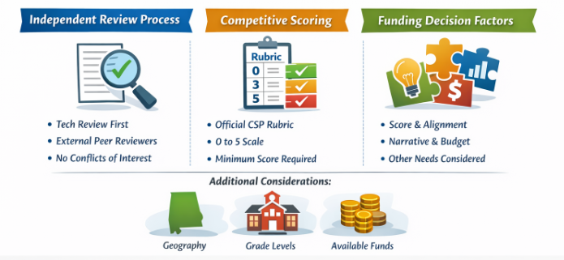
Scoring
Alabama Public Charter School Commission | Professional Development Training
Notes:
All eligible applications first go through a technical review by our team to make sure eligibility requirements are met and that the application is complete. If something is missing or unclear related to eligibility, that gets flagged at that stage.
Once an application clears technical review, it moves to external peer reviewers. These reviewers do not have a vested interest in the schools applying. We intentionally separate the grant review process from our authorizing work to ensure fairness and objectivity.
Applications are scored using the official APCSC CSP rubric. Each criterion is scored on a 0, 3, or 5 scale. 0 means the response does not meet expectations. 3 means it partially meets expectations. 5 means it fully meets expectations.
You must meet the minimum overall score to even be considered for funding. This is a competitive process, and not all eligible applications will necessarily receive funding.
The peer review score is the primary driver of funding recommendations. What really matters is alignment — strong applications clearly connect their narrative, performance measures, and budget. If those three things are working together, reviewers can easily see the strength of your proposal.
If needed, additional considerations such as geographic distribution, grade levels served, and available funding may come into play. But the rubric score comes first.
And I always tell applicants — the rubric is not hidden. If you answer the rubric directly and clearly, you are putting yourself in the strongest position possible.

Slide 9
Allowable Costs
Planning and Pre-Opening Staff
Curriculum and Instructional Materials
Startup Operations
Recruitment and Community Engagement
Consultants and Technical Support
All costs must be reasonable, necessary and directly tied to opening or expanding
Alabama Public Charter School Commission | Professional Development Training
Notes:
Planning & Pre-Opening Staff
Planning-year salaries for key personnel
Professional development for teachers & leaders
Stipends tied to grant activities
✅ Curriculum & Instructional Materials
Curriculum development
Instructional materials
Assessment tools
Technology & equipment
✅ Startup Operations
Minor facility renovations (not construction)
Furniture & classroom setup
One-time transportation startup costs
✅ Recruitment & Community Engagement
Student recruitment
Staff recruitment
Marketing & outreach
Community engagement events
✅ Consultants & Technical Support
Legal or financial setup support
Governance training
Coaches or instructional consultants
These funds are for opening and preparing to operate — not for sustaining ongoing school operations.
Every cost must connect clearly to your proposed activities and outcomes.

Slide 10
Unallowable Costs
Construction
Sustained Operational Costs
Governance Honorariums
Subscriptions (after the first payment or contract term)
All costs must be reasonable, necessary and directly tied to opening or expanding
Alabama Public Charter School Commission | Professional Development Training
Notes:
🚫 Construction
New building construction
Major capital improvements
🚫 Sustained Operational Costs
Ongoing instructional salaries after opening
Recurring operating expenses
Costs that will continue beyond the grant period
🚫 Supplanting
Replacing state or federal formula funds
Covering costs already funded elsewhere
🚫 Tuition & Instructional Delivery
Online tuition payments
Paying for student instruction directly
🚫 Governance Payments
Honorariums to board members

Slide 11
Facility Related Costs
Occupancy and Code Compliance
Space Activation for New Students
Pre-Opening Compliance
Storm Shelters (where required)
Alabama Public Charter School Commission | Professional Development Training
Notes:
🚫 Construction
New building construction
Major capital improvements
🚫 Sustained Operational Costs
Ongoing instructional salaries after opening
Recurring operating expenses
Costs that will continue beyond the grant period
🚫 Supplanting
Replacing state or federal formula funds
Covering costs already funded elsewhere
🚫 Tuition & Instructional Delivery
Online tuition payments
Paying for student instruction directly
🚫 Governance Payments
Honorariums to board members

Slide 12
Budget
CSP Subgrant Budget Template .xlsx
Alabama Public Charter School Commission | Professional Development Training
Notes:
When Opening the Budget Template
This budget should reflect your story. If it’s not described in your narrative, it shouldn’t be here.
Every cost must be allowable, reasonable, necessary, and tied directly to opening or expansion.
Think of this as startup funding — not operating funding.
Summary Budget Tab
Totals must match across all tabs.
Make sure the request stays within the cap for your subgrant type.
Large line items should have clear justification in the narrative.
If I see a big number, I should immediately understand what it’s for.
Planning Year
Planning funds are for preparing to open or expand — not for operating the school.
Salaries during planning should be tied to planning activities.
If you’re requesting salary during implementation, that usually requires a waiver.
Ask: Would this cost exist if the school wasn’t open yet?
Implementation Year(s)
Grant funds generally should not cover ongoing instructional salaries.
Startup costs should decrease over time.
Purchases should make sense based on projected enrollment.
If this cost continues after the grant ends, how will it be funded?
On Personnel
Who is being paid?
What specifically are they doing under the grant?
Is this a one-time startup need or a permanent operational role?
If this is a core operating position, what’s the sustainability plan?
On Purchases
Is this necessary for opening or expanding?
Is the cost reasonable?
Is this a one-time purchase or something recurring?
Is there duplication across years?
On Recruitment & Marketing
Recruitment is allowable, especially pre-opening.
Marketing should taper once enrollment stabilizes.
Recruitment efforts should align with access and equity goals.
On Sustainability
What happens when the grant ends?
Does enrollment growth support the shift away from grant funding?
Is there a clear revenue plan beyond CSP?
If Something Feels Off
Questions you can ask:
Help me understand how this connects to your proposed activities.
Where is this described in your narrative?
How is this cost different from regular operating expenses?
What funding source will replace this after CSP?
Is this something you would need every single year?

Slide 13
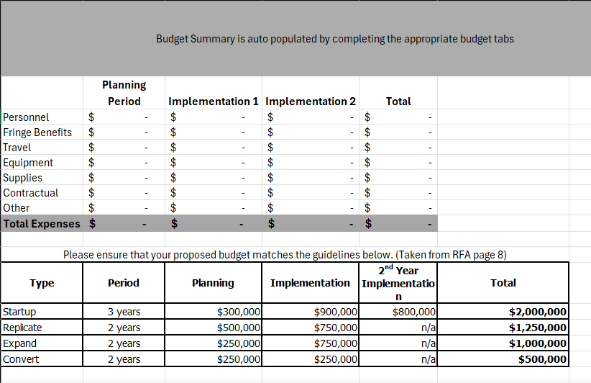
Alabama Public Charter School Commission | Professional Development Training

Slide 14

Key Dates
March 30, 2026 Applications Due in Anvilar
April & May: Peer Review
June 5, 2026: Awards Announced
Mid-June 2026: Required Post Award Meeting
Late June/July (TBD): Round II Application Round

Slide 15
Questions and Discussion

