Slide 1

Professional Development Training
March 9–10, 2026
Charter School Leadership Training | Montgomery, Alabama
Alabama Public Charter School Commission

Slide 2
Financial Metrics
Dr. Douglas Riley, Finance Specialist
Alabama Public Charter School Commission | Professional Development Training

Slide 3

Agenda
School Finance Organizationally
Sources of Funds
APCSC Oversight
Sources of Information
Financial Statements
Financial Indicators
Examples and APCSC Benchmarks
Alabama Public Charter School Commission | Professional Development Training

Slide 4


Organization
The governing board of a charter school…
…has autonomy over key decisions including, but not limited to, decisions concerning finance, personnel, scheduling, curriculum, instruction, and procurement. Ala. Code § 16-6F-4(16)a.
Financial Duties of the Board
FY budget Ala. Code § 16-13-140.
Monthly financial statements Ala. Code § 16-13A-1.
Monthly check registers Ala. Code § 16-13A-1.
Procurement Ala. Code § 16-13A-9.
Debt Ala. Code § 16-6F-9.
Contracts Ala. Code § 16-13B-1.
Insurance Ala. Code § 16-6F-9(b)(2).
Annual Audit Ala. Code § 16-13A-7.
Transparency Ala. Code § 16-13A-6.
Governing Board
Head of School
CSFO
The powers, obligations, and responsibilities…
… cannot be delegated or assigned…
Ala. Code § 16-6F-9(c)(5).
Alabama Public Charter School Commission | Professional Development Training

Slide 5

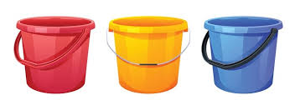
Sources of Funds
State Funds
Foundations Program
RAISE Act
Nurse
Technology
Transportation
Capital Purchase
Etc.
Federal Funds
Title Funds
CNP
IDEA Funding
CSP Grants
Other Grants
Etc.
Local & Donations
Charter School Growth Fund
NewSchools Venture Fund
New Schools For Alabama
Private Donations
Etc.
Alabama Public Charter School Commission | Professional Development Training

Slide 6

APCSC Oversight
An authorizer shall continually monitor the performance…
…including collecting and analyzing data…so long as those activities…
…do not unduly prohibit the autonomy granted to public charter schools.
Ala. Code § 16-13A-68(b)(1).
Indicators
Near Term Indicator
Current Ratio, Days Cash, Debt Default, Rev2Bud, Exp2Bud.
Sustainability Indicator
Current Net, Carry-Over, Total Margin, Aggregated 3yr Margin,
Debt-to-Asset Ratio, Net per Student,
Carry-over per Student.
Flexibility Indicator
State & Fed Funding Percentage.
Financial Management & Oversight Indicator
Governance, Policies, Reporting, Audit.
Alabama Public Charter School Commission | Professional Development Training

Slide 7
Sources of Information
An authorizer shall continually monitor the performance…
…including collecting and analyzing data…so long as those activities…
…do not unduly prohibit the autonomy granted to public charter schools.
Ala. Code § 16-13A-68(b)(1).
Publicly Available
Fiscal Year Budget
Monthly Financial
Statements
Monthly Check Registers
Governing Board Agendas
Governing Board Minutes
Annual Audit
APCSC Anvilar Submissions
Fiscal Year Budget
Annual Audit
Budget Amendments
EoY Financial Statements
Debt Default Assurance
School Enrollments
APCSC Staff Activities
Site Visit Reports
VCMs
Compliance Monitoring
Publicly Available Financial Data
Alabama Public Charter School Commission | Professional Development Training

Slide 8
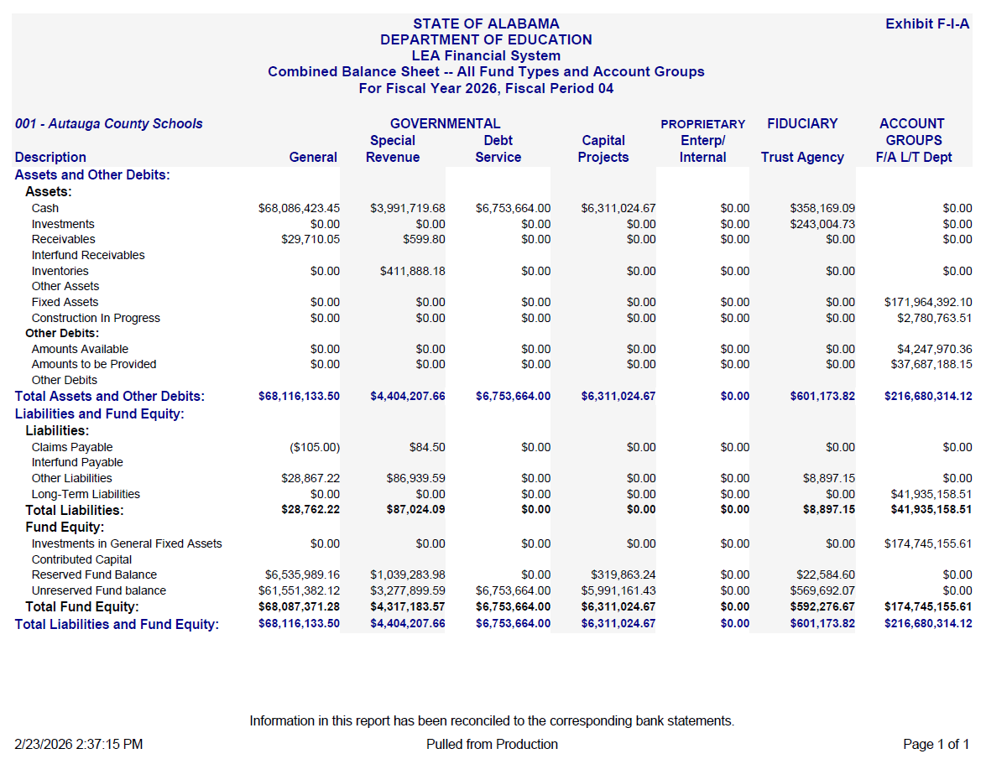
Monthly Financial Statement (F-I-A)
Alabama Public Charter School Commission | Professional Development Training

Slide 9
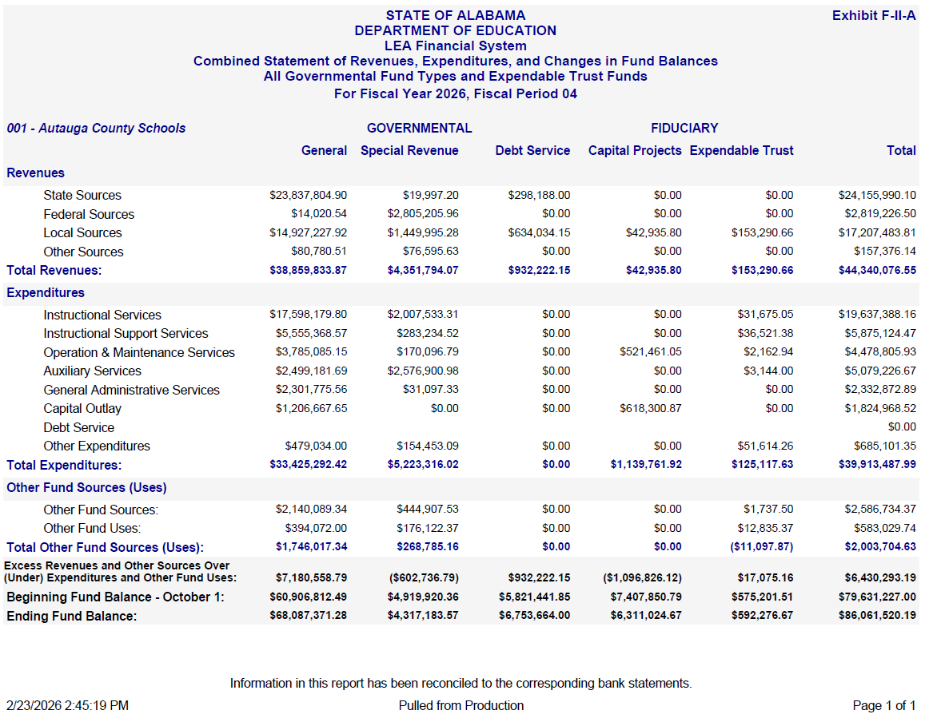
Monthly Financial Statement (F-II-A)
Alabama Public Charter School Commission | Professional Development Training

Slide 10
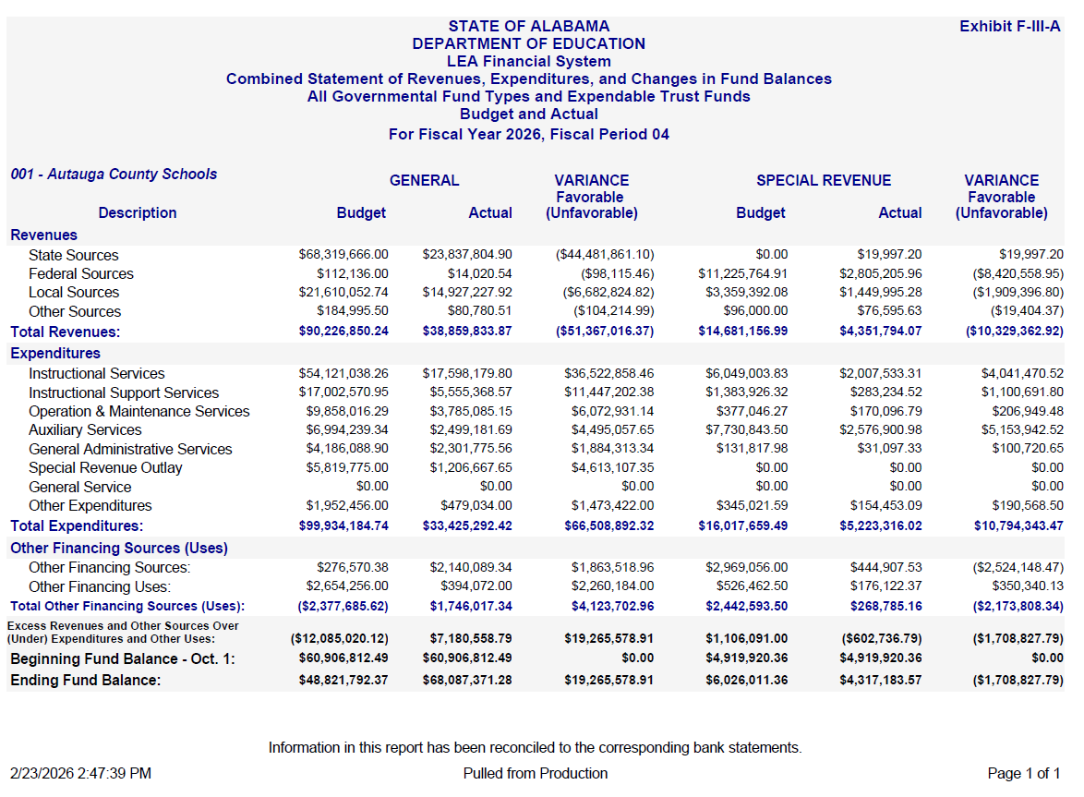
Monthly Financial Statement (F-III-A)
Alabama Public Charter School Commission | Professional Development Training

Slide 11
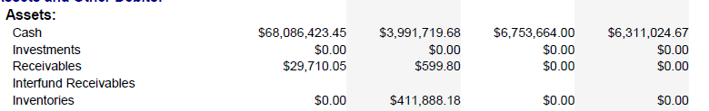
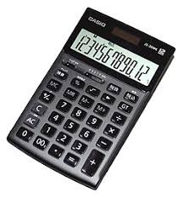
Near Term – Days Cash Calculation
Days Cash = ( Cash on Hand ) / (Average Daily Expense)
Cash on Hand = 68,086,000 + 3,992,000 + 6,754,000 + 6,311,000 = $ 85,143,000
Expenditure Sum YTD = 33,425,000 + 5,223,000 + 0 + 1,140,000 = $ 39,788,000
Average Daily Expense = (39,788,000 / 365 ) / ( 4 / 12) = $ 327,000
Days Cash = 85,143,000 / 327,000 = 260 Days
Alabama Public Charter School Commission | Professional Development Training

Slide 12


Near Term Indicator
Measure Benchmarks
Measure | Meets | Approaches | Does Not Meet
Current Ratio | > 1.1 | 0.9 – 1.1 | < 0.9
Days Cash | > 60 | 30 - 60 | < 30
Debt Default | No | Not Available | Yes
Measures:
Current Ratio, Days Cash,
Debt Default, Rev2Bud, Exp2Bud.
Near Term Indicator Ratings Chart
Meets | Debt Default = “No”, Days Cash > 60; Debt Default = “No”, Days Cash > 30, Current Ratio > 1.1.
Approaches | Debt Default = “No”, Days Cash > 30, Current Ratio > 0.9; Debt Default = “No”, Days Cash > 15, Current Ratio > 10.0;
Does Not Meet | Debt Default = “Yes”; School does not qualify for a higher rating.
Charter School
Current Ratio = 10.2, Days Cash = 45, Debt Default = “No”
Alabama Public Charter School Commission | Professional Development Training

Slide 13
Sustainability Indicator
Measure Benchmarks
Measure | Meets | Approaches | Does Not Meet
Total Margin | > 0.02 | -0.02 – 0.02 | < - 0.02
3-Yr Margin | > 0.02 | -0.02 – 0.02 | < - 0.02
Debt-to-Asset | < 0.9 | 0.9 – 1.0 | > 1.0
CO per Student | > 5000 | < 5000 | Not Available
Measures:
Current Net, Carry-Over, Total Margin, Aggregated 3yr Margin, Debt-to-Asset Ratio, Net per Student, Carry-Over per Student.
Sustainability Indicator Ratings Chart
Meets | Total Margin > 0.02, Debt-to-Asset Ratio < 0.9; Aggregated 3-yr Margin > 0.02, Debt-to-Asset Ratio < 0.9; Total Margin > 0, Aggregated 3-yr margin > 0, Debt-to-Asset Ratio < 0.7; Total Margin > 0, Aggregated 3-yr margin > 0, CO per Student > $5000, Debt-to-Asset Ratio < 0.9.
Approaches | Total Margin > 0, Aggregated 3-year Margin > 0; Debt-to-Asset Ratio < 0.9; Total Margin > 0, Debt-to-Asset Ratio < 0.7; Aggregated 3-year Margin > 0, Debt-to-Asset Ratio < 0.7;
Does Not Meet | School does not qualify for a higher rating.
Alabama Public Charter School Commission | Professional Development Training

Slide 14

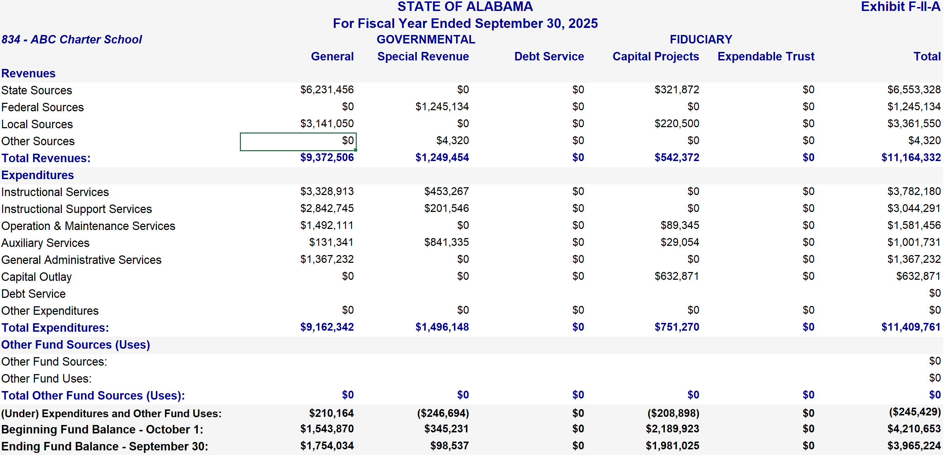
ABC Charter School
Total Margin = (Current Net) / (Total Act Rev)
Current Net = (Total Act Rev) – (Total Act Exp)
Alabama Public Charter School Commission | Professional Development Training

Slide 15
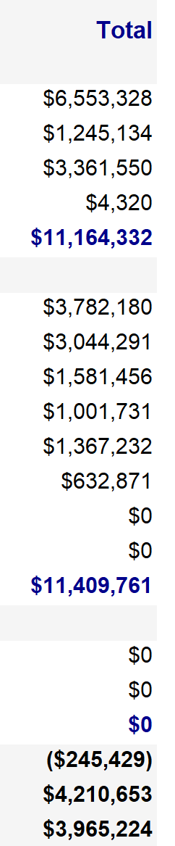
ABC Charter School
Total Margin = (Current Net) / (Total Act Revenues)
Current Net = (Total Act Revenues) – (Total Act Expenses)
Total Act Rev = $ 11,164,322
Current Net = ($245,429)
Total Margin = -2.20 %
Alabama Public Charter School Commission | Professional Development Training

Slide 16

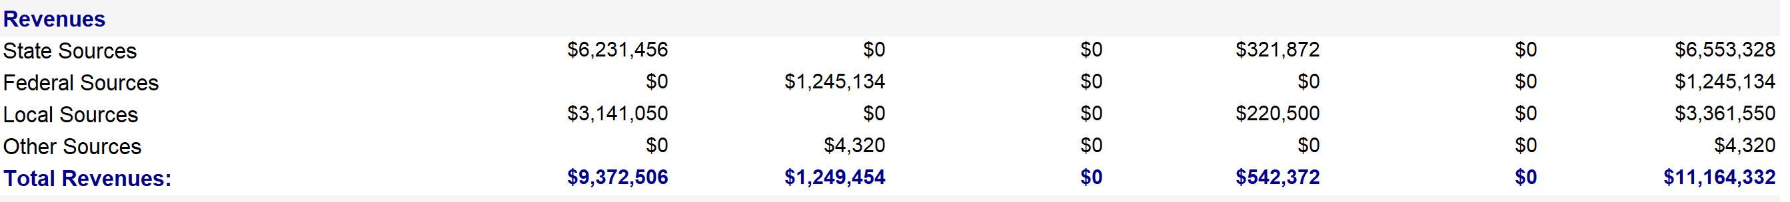
Flexibility Indicator
Measure Benchmarks
Measure | Meets | Approaches | Does Not Meet
State & Fed Funding % | < 90% | > 90% | Not Available
Measures:
State & Federal Funding Percent.
Charter School
Funding Percentage = (6,553,328 + 1,245,134) / 11,164,322 = 70%
Alabama Public Charter School Commission | Professional Development Training

Slide 17
Management & Oversight Indicator
Measure Benchmarks
Measure | Meets | Approaches | Does Not Meet
Governance | Meets five Board Duties | Slightly weaker descriptions | No higher ranking
Policies | Meets four structural metrics | Slightly weaker conditions | No higher ranking
Reporting | Prompt posting of financials | Slightly longer timelines | No higher ranking
Audits | Unmodified, no findings | Unmodified | No higher ranking
Measures:
Governance, Policies, Reporting, Audits.
Management & Oversight Indicator Ratings Chart
Meets | All four measures “Meets” expectations
Approaches | Three of the four measures “Meets” expectations, and the remaining measure “Does Not Meet” expectations; All four measures “Meets” or “Approaches” expectations.
Does Not Meet | School does not qualify for a higher rating.
Alabama Public Charter School Commission | Professional Development Training

Slide 18
ABC Charter School
I. Near-Term Financial Health
Metric | Calculation | Benchmark | Rating
Current Ratio | 10.2 | ≥ 1.1 | Meets
Days Cash | 45 | 60+ Days | Approaches
Debt Default | No | No | Meets
Revenue to Budget Ratio | 0.95 | Informational
Expense to Budget Ratio | 1.02 | Informational
Overall Rating | Meets
II. Financial Sustainability
Metric | Calculation | Benchmark | Rating
Current Net | $ (245,429) | Informational
Carry-Over | $ 3,964,224 | Informational
Total Margin | -2.20% | ≥ .02 (aka 2%) | Does Not Meet
Aggregated 3-yr Margin | 3.18% | ≥ .02 (aka 2%) | Meets
Debt-to-Asset Ratio | 0.12 | ≤ 0.9 | Meets
Net per Student | $ (437) | Informational
Carry-over per Student | $ 7,066 | ≥ $5,000 | Meets
Overall Rating | Meets
III. Financial Flexibility
Metric | Calculation | Benchmark | Rating
State & Federal Funding Percent | 69.85% | ≤ 90% | Meets
Overall Rating | Meets
IV. Financial Management & Oversight
Metric | Evidence for Rating |  | Rating
Governance | Financial information discussed at board meetings. Board approved budget. |  | Meets
Financial Policies | No findings concerning financial policies. |  | Meets
Financial Reporting | Financial information is available on the website. |  | Meets
Audit Findings | Unmodified audit, no findings. |  | Meets
Overall Rating | Meets
Alabama Public Charter School Commission | Professional Development Training

Slide 19

Questions and Discussion
We welcome your questions and feedback.

