Slide 1

APCSC Chartered Course: Staying in the Wake and Above Board in Academics
March 9–10, 2026
Charter School Leadership Training | Montgomery, Alabama
Alabama Public Charter School Commission

Slide 2
Academics
Alabama Public Charter School Commission | Professional Development Training

Slide 3
Staying in the Wake and Above Board in Academics
Academic Performance Framework
Mission Specific Measures
Alabama Continuous Improvement Plan (ACIP)
Counseling and Guidance
MTSS
School Libraries
Transcript Audit
Student Handbook
ACT 2024-34
School Calendar
Alabama Public Charter School Commission | Professional Development Training

Slide 4

Academic Performance Framework
The Academic Performance Framework (APF) includes measures that allow the Alabama Public Charter School Commission (“the Commission”) to evaluate charter school academic performance.
The APF answers the evaluative question: Is the academic program a success?
A charter school that meets the standards in this area is implementing its academic program effectively, and student learning—the central purpose of every school—is taking place.
Alabama Public Charter School Commission | Professional Development Training

Slide 5
Academic Performance Framework: State Accountability System
With a Grade 12
Without a Grade 12
Indicator | Weight
Academic Achievement | 20%
Academic Growth | 30%
Graduation Rate | 25%
College and Career Readiness | 10%
Chronic Absenteeism | 10%
English Language Proficiency (ELP) | 5%
Indicator | Weight
Academic Achievement | 35%
Academic Growth | 50%
College and Career Readiness (CCR) | X
Chronic Absenteeism | 10%
English Language Proficiency (ELP) | 5%
Graduation Rate | X
Alabama Public Charter School Commission | Professional Development Training

Slide 6
Academic Performance Framework
*CCR definition-
Achieving a benchmark score on the ACT,
Scoring a 3, 4, or 5 on an Advanced Placement exam/scoring a 4, 5, 6, or 7 on an International Baccalaureate exam
Scoring silver level or above on ACT Work Keys
Earning a transcript college credit while still in high school
Earning an Industry Credential
Being accepted for enlistment into any branch of the military
Alabama Public Charter School Commission | Professional Development Training

Slide 7
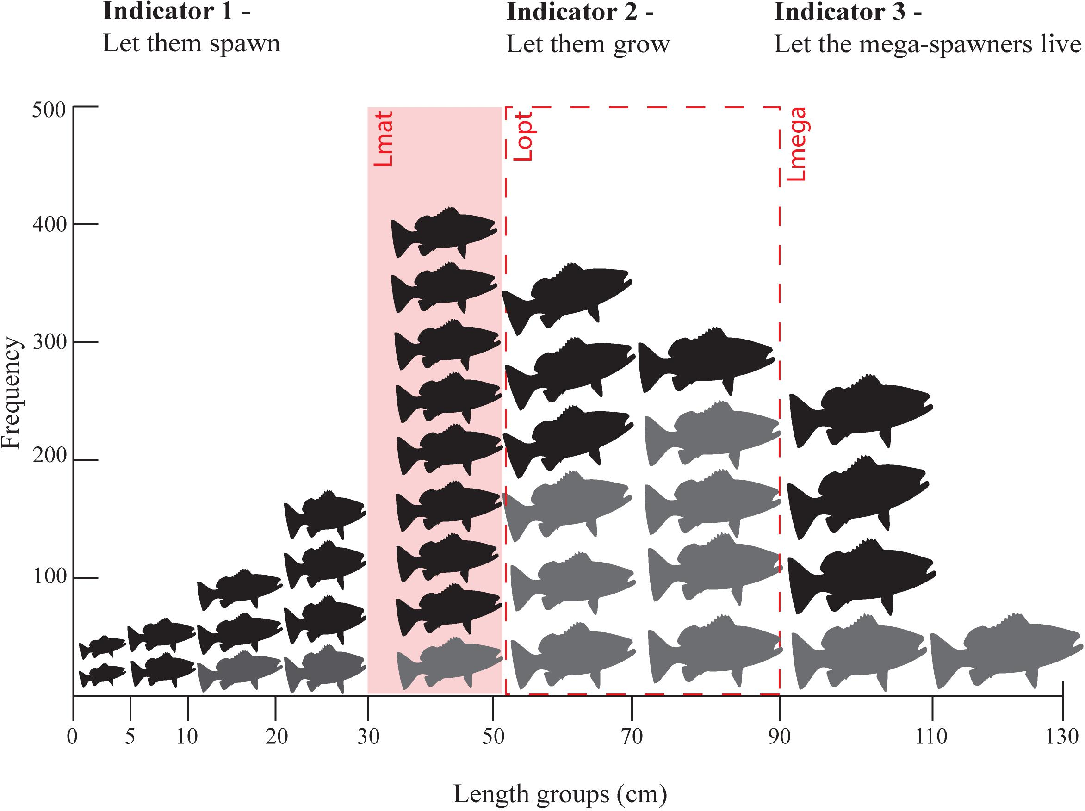
Academic Performance Framework: Additional Layer Part 2
Proficiency comparison to the local district
Subgroup proficiency comparison to local district
All students' growth comparison to local district
Subgroup growth comparison to local district
Graduation rate comparison to local district
Graduation rate subgroup comparison to local district
This Photo by Unknown Author is licensed under CC BY
Alabama Public Charter School Commission | Professional Development Training

Slide 8
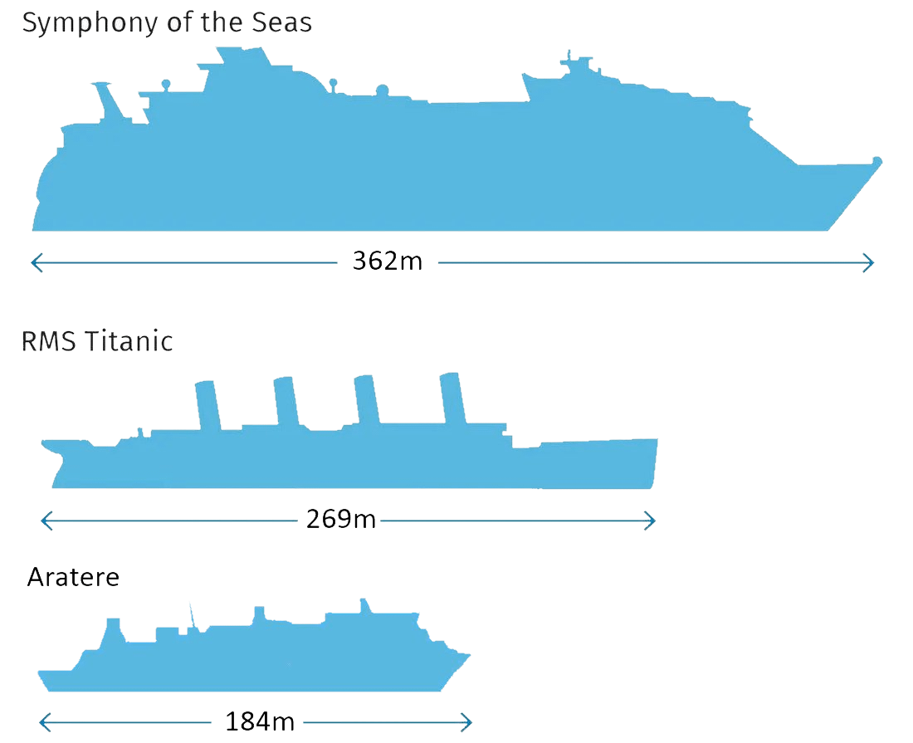
Academic Performance Framework Part 3
Comparison to Schools Serving Similar Students
Proficiency comparison schools serving similar students
Graduation rate comparison to schools serving similar students
Alabama Public Charter School Commission | Professional Development Training

Slide 9
Academic Performance Framework (Examples)
🎯 Goal 1: Reading
By May 2027, reading proficiency will increase from 42% to 55% as measured by ACAP.
🎯 Goal 2: Math
By May 2027, math proficiency will increase from 38% to 50%.
🎯 Goal 3: Attendance
Reduce chronic absenteeism from 21% to 12% by the end of the 2026–2027 school year.
🎯 Goal 4: Graduation Rate
Increase graduation rate from 87% to 92%.
Alabama Public Charter School Commission | Professional Development Training

Slide 10
Mission Specific Measures: Additional Layer (Examples)
For a STEM-Focused Charter School
Student Innovation Projects:
By May 2027, 90% of students in grades 9–12 will successfully complete and present a standards-aligned capstone engineering or computer science project, evaluated using a project-based learning rubric with at least 80% scoring proficient or higher.
Industry Exposure:
Beginning in the 2026–2027 school year, 100% of students in grades 6–12 will participate in at least 10 hours per semester of STEM-related mentorship, internship, job-shadowing, or field experience, documented through partnership logs and student reflection journals.
For an Arts-Integrated Charter School
Performance & Exhibition Rates:
By May 2027, 95% of students will participate in at least one public performance, gallery exhibition, or arts showcase annually, documented through event programs and participation rosters.
Arts Literacy:
Between Fall 2026 and Spring 2027, students will demonstrate a 15% increase in proficiency in analyzing and critiquing artistic works, as measured by a standards-aligned arts literacy rubric administered at the beginning and end of the school year.
Alabama Public Charter School Commission | Professional Development Training

Slide 11
Simple Summary
Area | Traditional School | Charter School
State A–F Grade | ✅ Yes | ✅ Yes
Same Weighting Formula | ✅ Yes | ✅ Yes
Performance Contract | ❌ No | ✅ Yes
Renewal Every 5 Years | ❌ No | ✅ Yes
Closure for Underperformance | Rare | Possible & Contractual
Financial Oversight Layer | District-managed | Independent audit + authorizer review

Slide 12
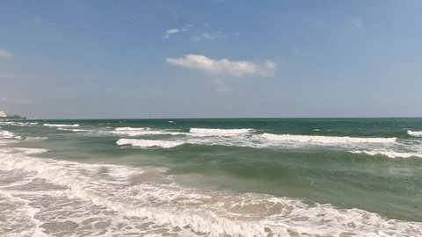
Alabama Continuous Improvement Plan
Ongoing, working document that guides how a school plans, implements, monitors, and refines its improvement efforts to support student achievement and overall school effectiveness.
It isn’t a one-time plan — it’s reviewed regularly and updated based on the progress that’s made.
Alabama Public Charter School Commission | Professional Development Training

Slide 13
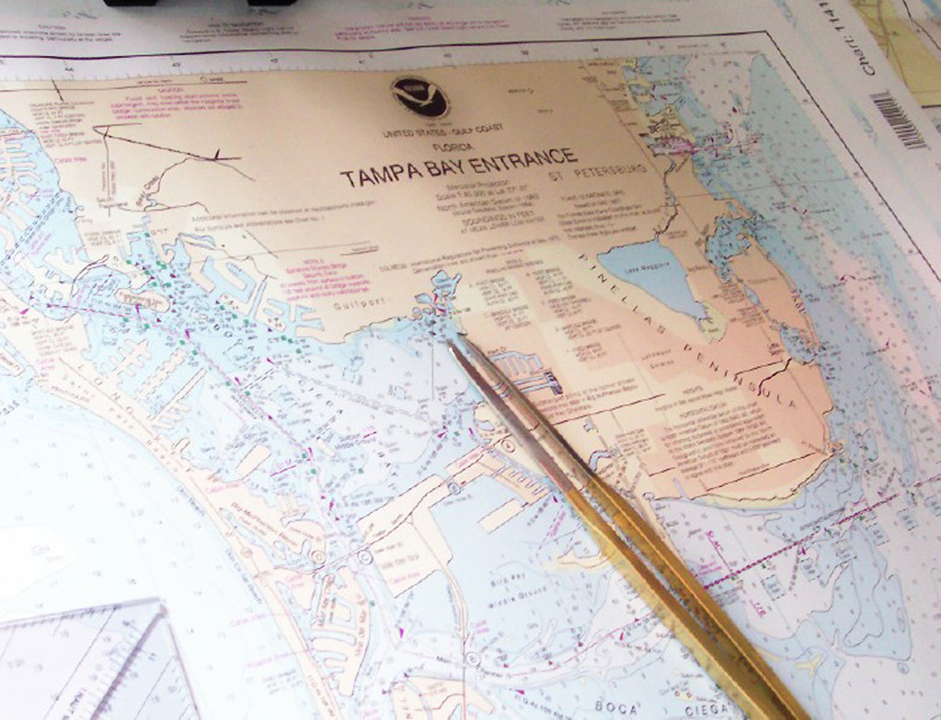
Alabama Continuous Improvement Plan
🎯 Primary Purpose
The ACIP serves as a strategic roadmap for continuous improvement across all key areas of school performance. It helps schools:
Identify strategies and actions that address achievement gaps and instructional needs.
Set measurable goals based on analyzed data.
Monitor progress and adjust practices based on evidence.
Support equitable outcomes for all learners.
This Photo by Unknown Author is licensed under CC BY
Alabama Public Charter School Commission | Professional Development Training

Slide 14
Alabama Continuous Improvement Plan
🧠 Key Components Often Included
ACIPs include:
1. Data Analysis & Needs Assessment A review of academic achievement, growth data, attendance, discipline, achievement gaps, etc., that identifies strengths and areas needing improvement.
2. Goals & Objectives Clear, measurable targets tied to student outcomes (e.g., increase proficiency in reading/math, graduation rate goals, closing achievement gaps).
3. Strategies & Action Steps Evidence-based practices, instructional interventions, professional learning plans, and resource allocations designed to meet goals.
4. Monitoring/Progress Measures How progress will be tracked — including timelines, responsible staff, and data checkpoints to ensure activities are working.
5. Stakeholder Engagement Documentation that teachers, parents, administrators, and community members participated in plan development and review.
6. School Culture & Climate Considerations Some plans also include non-academic factors like safety, discipline, attendance, and engagement strategies.
Alabama Public Charter School Commission | Professional Development Training

Slide 15
Alabama Continuous Improvement Plan
👥 How It’s Developed
The plan is collaboratively created by a team that typically includes the principal, counselors, teachers, parent representatives, and other stakeholders.
Plans are approved by the local school board and signed off by leadership such as the superintendent and principal.
Alabama Public Charter School Commission | Professional Development Training

Slide 16
Alabama Continuous Improvement Plan
📅 Timeline & Review
ACIPs are usually effective for a two-year period.
They are regularly reviewed and revised often (monthly or as data is analyzed) to make sure goals and strategies remain relevant.
Alabama Public Charter School Commission | Professional Development Training

Slide 17
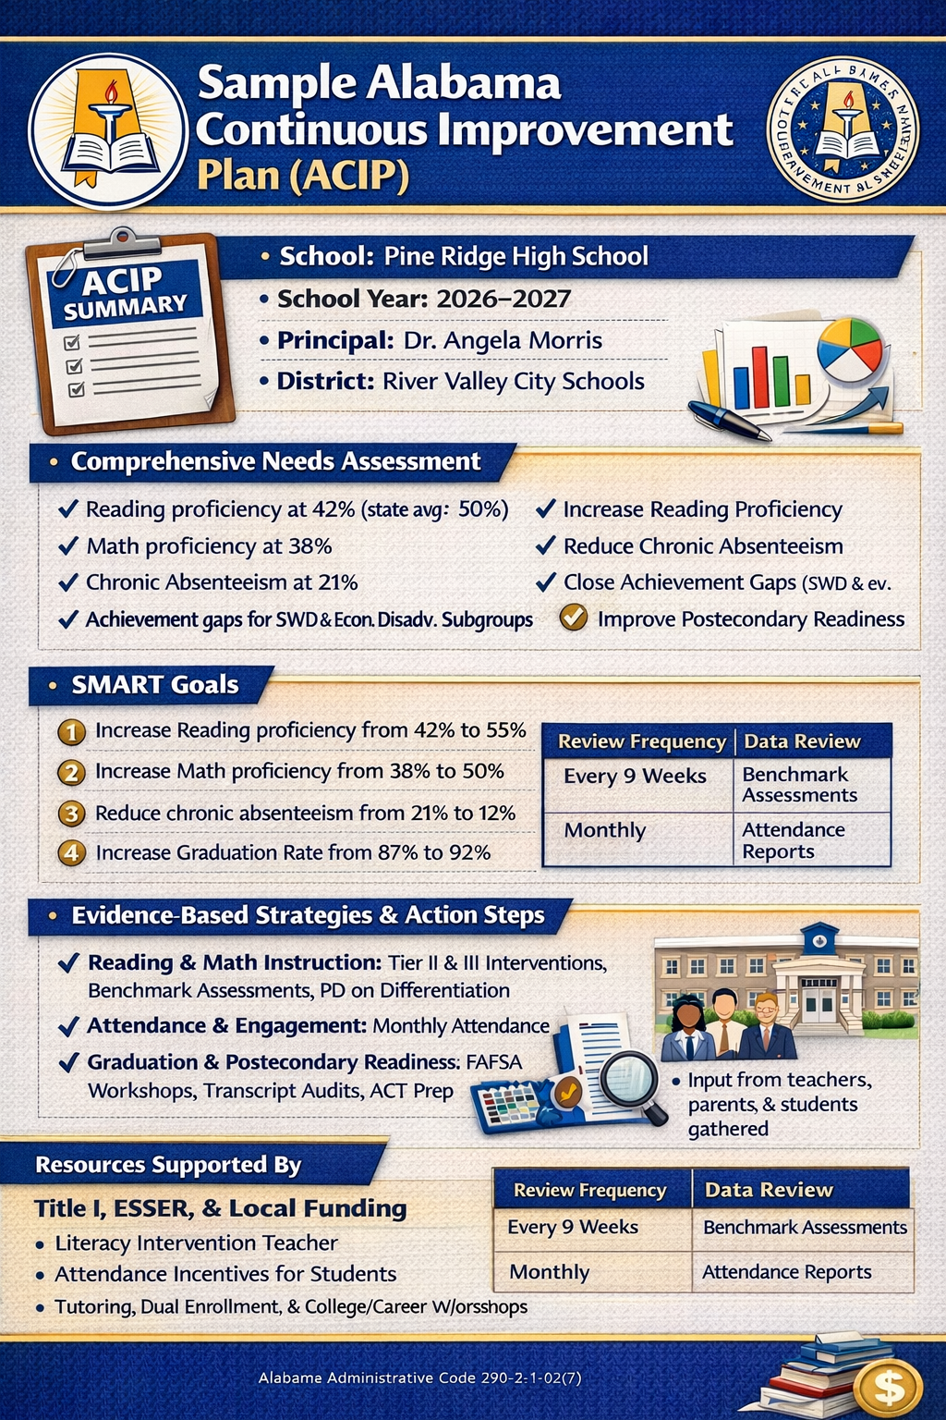
Alabama Continuous Improvement Plan
Alabama Public Charter School Commission | Professional Development Training

Slide 18

Counseling and Guidance
Alabama Public Charter School Commission | Professional Development Training

Slide 19
Counseling and Guidance
Has the school developed and implemented a comprehensive counseling and guidance program with certified counselors that ensure that every student achieves the minimum counseling competencies at each appropriate grade level?
Documentation:
1. LEA Comprehensive Counseling Plan
Copy of the district’s comprehensive counseling and guidance plan
Must be aligned to the Comprehensive Counseling and Guidance State Model for Alabama Public Schools (Bulletin 2003, No. 89)
Comprehensive Counseling and Guidance Model for Alabama
2. Annual Plan Acknowledgement
One system-level letter on district letterhead
Signed and dated by the counseling coordinator
Verifying each school’s plan is updated annually and maintained at both the school and district levels
3. Ethical Standards Acknowledgement
One system-level letter on district letterhead
Signed and dated by the counseling coordinator
Verifying adherence to ethical guidelines and professional standards for school counseling
Alabama Public Charter School Commission | Professional Development Training

Slide 20

Counseling and Guidance
Has the LEA ensured that counselors at each school have implemented a comprehensive counseling and guidance program that ensures equal access and appropriate placement of students by utilizing test data and other available information?
Documentation:
Interviews/Observation
Alabama Public Charter School Commission | Professional Development Training

Slide 21
Counseling and Guidance
An annual administrative conference is documented by the school counselor and supervising administrator within the first two months of school which provides rationale for use of time based on data and goals, the roles and responsibilities of the school counselor, and areas identified for school counselor professional development?
Documentation:
Copy of Annual Administrative Conference/Agreement for each school counselor developed and signed by school counselor and school administrator for the current school year.
Alabama Public Charter School Commission | Professional Development Training

Slide 22
Counseling and Guidance
Has the LEA developed and followed a calendar of activities and implemented a planned sequential program where counselors spend 80% of their time providing services through the four required program components: school guidance curriculum, individual student planning, responsive services, and system support?
Documentation:
Use of time assessment results from one week (5 consecutive days) should be submitted for each school counselor
Schedules should be submitted for each school counselor
Copy of yearly and monthly calendar of counseling and guidance activities which demonstrate individual, small group, and large group counseling activities for each school.
Alabama Public Charter School Commission | Professional Development Training

Slide 23

Counseling and Guidance
Has the LEA established a system-wide Counseling and Guidance Advisory Council?
Required Evidence:
Advisory Council Membership List
Current roster of LEA Counseling and Guidance Advisory Council members
Must include stakeholder representation from:
Education
Business/Industry
Community
Mental Health Partners
Meeting Documentation
Agendas
Minutes and documented outcomes
Evidence of discussion and action items
Grade-Level & Cluster-Specific Activities Meeting documentation must demonstrate inclusion of activities for:
Elementary
Middle School/Junior High
High School
K–12 (as applicable)
Alabama Public Charter School Commission | Professional Development Training

Slide 24
Counseling and Guidance (Advisory Council)
Name | Title/Role | Representing | Organization | Email/Phone
Dr. Angela Smith | Director of Counseling | Education | LEA Central Office
John Davis | School Counselor | Education | High School
Maria Lopez | Principal | Education | Elementary School
Mark Reynolds | HR Manager | Business/Industry | ABC Manufacturing
Lisa Carter | Workforce Development Rep | Business/Industry | Local Chamber of Commerce
Rev. Thomas Green | Community Leader | Community | First Community Church
Dr. Natalie Brooks | Licensed Therapist | Mental Health | County Mental Health Center
Officer James Hill | School Resource Officer | Community | Local Police Dept.
Parent Representative (2) | Parent | Community | Parent Organization
Student Representative (HS) | Student | Education | High School
Alabama Public Charter School Commission | Professional Development Training

Slide 25
Counseling and Guidance (Agenda)
🗂 Sample Advisory Council Meeting Agenda
LEA Counseling & Guidance Advisory Council Meeting Date: October 15, 2025 Location: LEA Central Office Time: 3:30–5:00 PM
I. Call to Order
II. Review of Previous Meeting Minutes
III. Program Data Review
Attendance trends
Discipline data
Graduation/CCR updates
IV. Grade-Level & Cluster-Specific Updates
Elementary (K–5)
SEL curriculum implementation
Attendance intervention strategies
Middle School/Junior High (6–8)
Academic advising model
Career awareness activities
High School (9–12)
College & Career Readiness initiatives
FAFSA completion updates
Dual enrollment participation
K–12 Systemwide Initiatives
Suicide prevention programming
Mental health partnership updates
Crisis response procedures
V. Business & Community Partnerships Update
VI. Action Items & Recommendations
VII. Adjournment
Alabama Public Charter School Commission | Professional Development Training

Slide 26
Counseling and Guidance (Outcomes Summary)
📝 Sample Minutes/Outcome Summary (Abbreviated)
Key Outcomes:
Elementary counselors will implement quarterly SEL parent workshops.
Middle school will expand career exploration lessons to include local workforce speakers.
High school will host spring FAFSA night in partnership with community college.
Mental health partner will provide on-site counseling two days per week.
Next Meeting: January 20, 2026
Alabama Public Charter School Commission | Professional Development Training

Slide 27


Counseling and Guidance
Has LEA ensured that counselors at each school have collected and disaggregated results data measuring behaviors (such as graduation rates, attendance, behavior, academic achievement, data over time)?
Interviews
Alabama Public Charter School Commission | Professional Development Training

Slide 28
Counseling and Guidance
Has LEA ensured that counselors at each school have provided information to students, parents, and staff regarding the school counseling and guidance program?
Has LEA consulted with students, parents, teachers, other educators, and community agencies regarding strategies to help students achieve personal and academic advancement?
One system-level Community Resource List
Copies of school-level documentation of parental involvement activities and highlight the role of the school counselor, and other school-based mental health professionals, services offered, and referral procedures
Interviews
Alabama Public Charter School Commission | Professional Development Training

Slide 29
Counseling and Guidance: Example Resource List
📌 Example: System-Level Community Resource List
LEA Community Resource Directory School Year: 2025–2026
The LEA maintains a centralized Community Resource List available to all schools, families, and counseling staff. The directory is reviewed and updated annually.
Mental Health & Counseling Services
County Mental Health Center – Individual & Family Counseling
Regional Behavioral Health Services – Crisis Response
Licensed Private Practice Providers (List Attached)
Medical & Health Services
County Health Department – Immunizations & Health Screenings
Local Pediatric Clinics
School-Based Health Partnerships
Social Services
Department of Human Resources (DHR)
Family Assistance Programs
Local Food Banks & Clothing Closets
College & Career Resources
Local Community College Advising Office
Workforce Development Center
Career Technical Education (CTE) Partners
Crisis & Safety Resources
988 Suicide & Crisis Lifeline
Local Law Enforcement / School Resource Officers
Child Advocacy Center
Alabama Public Charter School Commission | Professional Development Training

Slide 30
Counseling and Guidance
Has LEA ensured that counselors at each school have assisted in early identification of students at-risk of school failure and facilitated in the delivery of preventive and intervening services?
Is there a systematic and consistent provision for the referral of students who exhibit barriers to learning?
One system-level acknowledgement on district letterhead, signed and dated by the counseling coordinator that documents the role of school counselor(s) as a key member of the school MTSS/RTI Team
Interviews
Alabama Public Charter School Commission | Professional Development Training

Slide 31
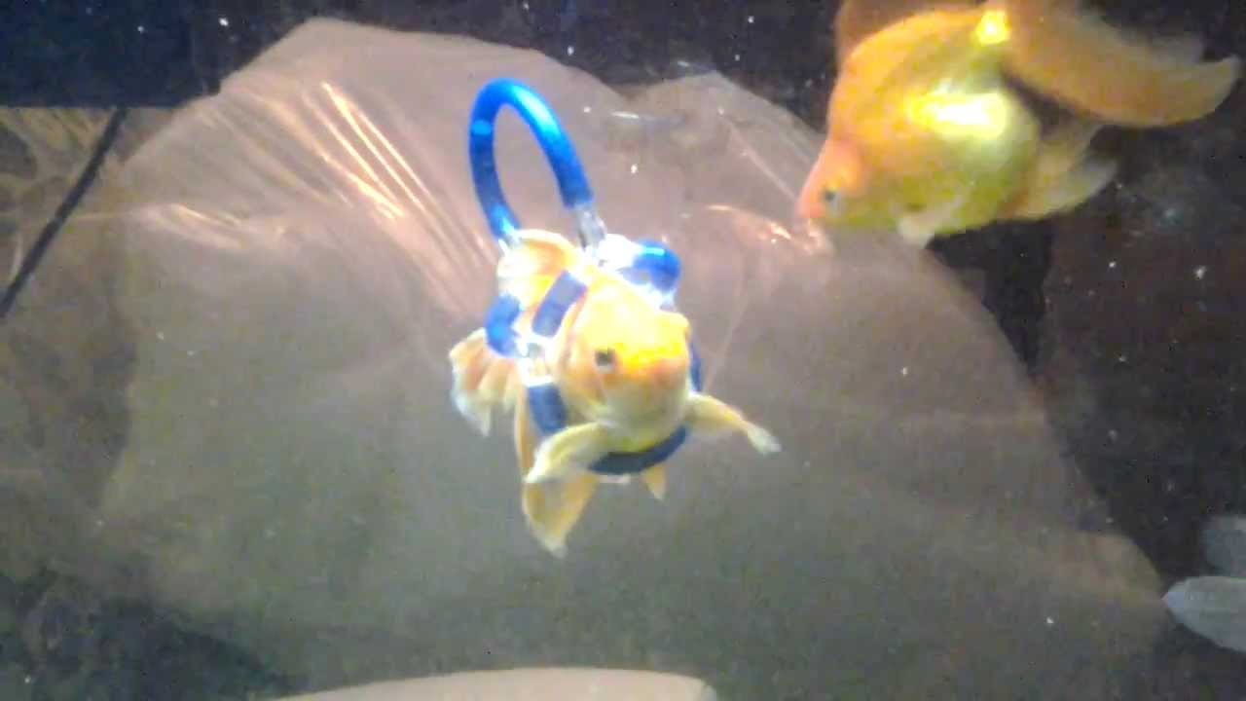
Counseling and Guidance
Has the LEA ensured that counselors at each school have provided adequate resources for instruction and delivery of guidance services?
Provided easily accessible and adequate facilities?
Coordinated guidance services with all aspects of the school program?
Observation
Interviews
Alabama Public Charter School Commission | Professional Development Training

Slide 32

Counseling and Guidance
Has LEA ensured that counselors at each school have provided guidance to students in the development and annual revision of a high school four-year educational plan and an educational/career plan?
(The personal education plan of study shall be approved in writing by the parent(s) or guardian(s) and become part of the student’s overall educational/career plan.)
Documentation required:
A minimum of three school-approved four-year education plans of study from freshmen and/or sophomores including signatures of parent(s) or guardian(s), student and approval of school counselor or career coach.
Alabama Public Charter School Commission | Professional Development Training

Slide 33

Counseling and Guidance
Have counselors provided guidance to
students regarding post-secondary, including the college application process, scholarships, career/military opportunities, and completing the Free Application for Federal Student Aid (FAFSA).
Copies of school-level documentation of post-secondary activities
Interview
Alabama Public Charter School Commission | Professional Development Training

Slide 34
Counseling and Guidance
Has the LEA ensured that counselors at each school have provided equal access, systemic evaluations, and follow-up studies to determine program revisions and promote awareness of the program?
Counseling and Guidance Program Needs Assessment results and follow-up data
One system-level acknowledgement on district letterhead, signed and dated by the counseling coordinator that documents completion of School Counseling Program Audit from previous school year, and copies are on file with the counseling coordinator.
Example:
Students' surveys
High school students requested additional FAFSA and scholarship support –
Implemented senior FAFSA completion night
Alabama Public Charter School Commission | Professional Development Training

Slide 35
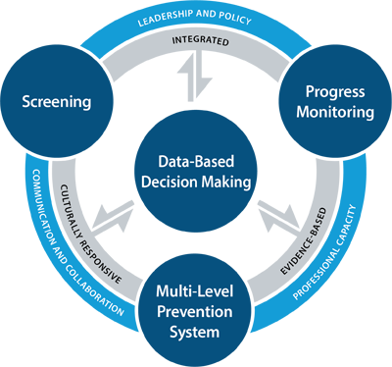
MTSS
Multi-Tiered Systems of Support (MTSS)
Alabama Public Charter School Commission | Professional Development Training

Slide 36

MTSS
Is there evidence of ongoing district-level involvement and support with Problem Solving Teams (PST) and regular data analysis review?
Alabama Administrative Code 290-3-1-.02(19)(a)(1)(2)
Documentation to be uploaded:
• System Acknowledgment Form
• Copy of meeting schedule
• Copy of agendas and sign in sheets
• Notes from Instructional Rounds
• Data review notes
Alabama Public Charter School Commission | Professional Development Training

Slide 37

MTSS
Is there evidence that each school has established a Problem-Solving Team (PST) and it meets regularly?
Alabama Administrative Code 290-3-1-.02(19)(b)
Documentation to be uploaded:
• School Acknowledgment Form from each school
• Copy of PST yearly schedule for all schools from each school
• Copy of agendas and sign in sheets from each school
• Examples of Professional Learning Communities (PLCs) or opportunities for staff collaboration from each school
Alabama Public Charter School Commission | Professional Development Training

Slide 38
MTSS
Is there evidence that universal screening tools are used to identify students who may need intervention?
(Screening tools include vision, hearing, academic, and behavioral). Rule 290-8-9-.03 Code of Ala. 1975, Title 16, Chapter 39; 20 U.S.C. 1401(3)(A)(B), 34 CFR§300 and AAC 290-3-1-.02(19)(a)(1)(2)(c)
Documentation to be uploaded:
• Copy of screening schedule (date, grades, area of assessment)
• List of screeners utilized (ALSDE approved with Alabama Literacy/Numeracy Act)
Alabama Public Charter School Commission | Professional Development Training

Slide 39
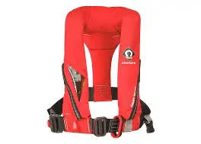
MTSS
Are parents/guardians notified and kept informed regarding student
progress during the PST process?
Alabama Administrative Code 290-3-1-.02(19)(b)
Documentation to be uploaded:
• Samples of parent letters with identifiable information redacted from each school
Alabama Public Charter School Commission | Professional Development Training

Slide 40
MTSS
Is there evidence that each school’s master schedule reflects dedicated time for intervention?
(Intervention includes, but is not limited to, general, gifted, supplemental, and special education services in providing high-quality, standards-based instruction and intervention that is matched to students’ academic, social emotional, and behavioral needs.)
Alabama Administrative Code 290-3-1-.02(19)(a)(1)
Documentation to be uploaded:
• Copy of school master schedule/calendar reflecting dedicated time for intervention from each school
Alabama Public Charter School Commission | Professional Development Training

Slide 41
MTSS (Example)
Time | Block | Description
7:45 – 8:00 | Homeroom | Attendance / Announcements
8:00 – 8:55 | 1st Period | Core Instruction
9:00 – 9:55 | 2nd Period | Core Instruction
10:00 – 10:45 | 3rd Period | Core Instruction
10:45 – 11:15 | Intervention / RTI Block | Targeted small-group instruction, tutoring, credit recovery, or enrichment
11:20 – 12:10 | 4th Period | Core Instruction
12:10 – 12:40 | Lunch | Lunch
12:45 – 1:35 | 5th Period | Core Instruction
1:40 – 2:30 | 6th Period | Electives
2:30 – 2:45 | Advisory | SEL / Academic Monitoring
Alabama Public Charter School Commission | Professional Development Training

Slide 42
MTSS
Is there evidence that school administrators and classroom educators are engaged in high-quality professional learning/development that is designed to improve their ability to implement the Alabama Course of Study standards, high quality instructional materials to ensure student mastery of academic standards, and evidence-based interventions?
Alabama Administrative Code 290-3-1-.02(18)
Documentation to be uploaded:
• Calendar of professional learning
• Agendas, sign-in sheets, etc. from professional learning
• Dates of coaching cycles, as applicable
Alabama Public Charter School Commission | Professional Development Training

Slide 43
MTSS
Alabama Public Charter School Commission | Professional Development Training

Slide 44
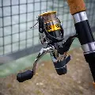
MTSS
Is there evidence that tiered instruction is taking place within the elementary and secondary classrooms?
Alabama Administrative Code 290-3-1-.02(19)(a)(1)
Documentation to be uploaded: • Sample of lesson plans from content areas/grade levels/courses [One (1) sample from each core content area (English Language Arts, Mathematics, Science, and Social Studies AND two (2) samples from electives courses] • Sample of elementary and secondary classroom schedules, as applicable
Alabama Public Charter School Commission | Professional Development Training

Slide 45
MTSS
Is there evidence that classroom educators are implementing the Alabama Course of Study standards for the courses taught?
Alabama Administrative Code 290-3-1-.02(18)
Documentation to be uploaded:
• Report showing alignment of activities to Alabama Courses of Study Standards
• Upload evidence of differentiated learning opportunities within daily lessons. Include samples lesson plans from content areas/course for elementary, middle, and high school. One (1) sample from each core content area (English Language Arts, Mathematics, Science, and Social Studies) AND two (2) samples from electives courses.
Alabama Public Charter School Commission | Professional Development Training

Slide 46
MTSS
Is there evidence that interventions are monitored and adjusted based on student progress?
Alabama Administrative Code 290-3-1-.02(19)(a)(2)(b)(c)
Documentation to be uploaded:
• Sample of elementary and secondary student plans, with identifiable information redacted
• Evidence of interventions/student plans will be accessed from the digital intervention platform within the Student Information System (SIS)
Alabama Public Charter School Commission | Professional Development Training

Slide 47

MTSS
Is there evidence of programs and supports that have been implemented prior to the required student exit interview?
Section 16-28-3.1 Act 2009-564, p. 1648, §2
Documentation to be uploaded:
• Sample of interventions, student/parent conferences, etc.to prevent student dropout
Alabama Public Charter School Commission | Professional Development Training

Slide 48
MTSS
Is there evidence of procedures which address chronic absenteeism prevention and awareness?
Alabama Administrative Code 290-3-1-.02(7)(b)(c)
Documentation to be uploaded:
• Agenda of planning sessions for chronic absenteeism related events
• Samples of chronic absenteeism related events and communication
• Documentation of parental awareness items related to chronic absenteeism, excluding truancy letters
Alabama Public Charter School Commission | Professional Development Training

Slide 49

School Libraries Media
Personnel: Are qualified school librarian/library media specialist units placed where earned as indicated by LEA Unit breakdown?
Ala. Admin. Code 290-2010.01(1)(a)1. (ii)
Documentation to be uploaded:
• Professional Educator Certificates of all school library media specialists employed; Upload professional educator certificates for all employed school library media specialists. Each foundational unit should be accounted for. Provisional Certificates (if applicable): If any non-certified library media specialists are employed, include documentation of provisional certificates
• Sample Library Certificates.
• Foundation Unit allocations for the LEA
Alabama Public Charter School Commission | Professional Development Training

Slide 50

School Libraries Media
Informational Access: Does the school library media specialist(s) provide flexible, real, and virtual access to a wide range of informational resources, both within the school library and outside the school facility?
Ala. Admin. Code 290-3-3-. 49 (Supp.6/30/13 3-3-228)
Documentation to be uploaded:
• Library Website Address: Submit a single PDF file containing all list web addresses (with clickable links) for each school library website.
• Minimum Website Requirements: Each school library website must include the following:
o Librarian’s Name
o Librarian’s Contact Information
o Library Hours
o Library Schedule
o Active link to school’s online catalog (OPAC)
o Active link to the Alabama Virtual Library
Alabama Public Charter School Commission | Professional Development Training

Slide 51
School Libraries Media
The Learning Environment: Is the Library Media Center flexibly scheduled
so that students and teachers have unlimited physical and intellectual access to resources?
Ala. Admin. Code 290-3-.49 (Supp. 6/30/13 3-3-228)
Documentation to be uploaded:
• Library Schedules: Provide the library schedule for every school for the current school year.
• In the Alabama Guidelines for Exemplary School Libraries it states, the school administrator should ensure the school librarian is able to maintain an effective school library program with open, flexible access by ensuring the school librarian is not used as a substitute and/or classroom teacher and is not assigned an abundance of non-library related tasks.
• In addition, the school administrator guarantees that the school librarian has 40% of his or her contract week reserved for management responsibilities that include, but are not limited to, implementing district and school collection development policies and procedures to evaluate and inform decisions about school library program’s resources and services, preparing materials and resources to be added to the collection, and planning strategically for services provided by the school library program. It is strongly encouraged that program management time be provided in no less than 30-minute increments and protected to ensure the school librarian can effectively serve students and educators.
Alabama Public Charter School Commission | Professional Development Training

Slide 52

School Libraries Media
The Learning Environment: Does the school librarian/library media specialists engage in curriculum-based and collaborative learning (including information literacy and technology literacy) opportunities with teachers to support student achievement?
Do lesson plans align with the Alabama Courses of Study?
Ala. Admin. Code 290-3-.49 (Supp. 6/30/13 3-3-228)
Documentation to be uploaded:
• Library Lesson Plans: Provide one lesson plan per ALSDE funded librarian unit. The librarian may select the lesson plan style or use one required by their district. The lesson plan should include the librarian’s name, school, grade level instructed, Alabama Course of Study (ACOS) standard, and the actual lesson. Supporting documents such as slide decks, videos, and handouts should not be included— only the lesson plan itself.
Alabama Public Charter School Commission | Professional Development Training

Slide 53
School Libraries Media
Assessment and Evaluation: Are the indicated reports used to evaluate
and enhance the library program: LEA Board Approved Policy Manual?
Ala. Admin. Code 290-3-3-.49 (Supp. 6/30/13 3-3-228)
Documentation to be uploaded:
A copy of the Local Board Approved School Library Media Policy and Procedure Manual must be uploaded into Cognia eProve Workspace. If the manual is available online, a direct link may be provided instead.
Alabama Public Charter School Commission | Professional Development Training

Slide 54
School Libraries Media
Assessment and Evaluation: Are the indicated reports used to evaluate
and enhance the library program: Circulation Report?
Ala. Admin. Code 290-3- 3-.49 (Supp.6/30/13 3-3-228)
Documentation to be uploaded:
• Upload a circulation report for the last completed school year (August start date - June 1).
• The report must be broken down by item class (e.g., 000-099, Fiction, Easy, Biography/92).
Alabama Public Charter School Commission | Professional Development Training

Slide 55
School Libraries Media
Assessment and Evaluation: Are the indicated reports used to evaluate
and enhance the library program: Collection Aging Report?
Ala. Admin. Code
290-3-3-.49 (Supp.6/30/13 3-3-228)
Documentation to be uploaded:
Upload a collection aging report for each school for the last completed school year.
Alabama Public Charter School Commission | Professional Development Training

Slide 56
School Libraries Media
Assessment and Evaluation: Are the indicated reports used to evaluate
and enhance the library program: Automation/Software Agreement?
Ala. Admin. Code 290-3-3-.49 (Supp. 6/30/13 3-3-228)
Documentation to be uploaded:
• Automation/Software Agreement from vendor
• Copy of purchase order/invoice for Automation/Software Agreement
Alabama Public Charter School Commission | Professional Development Training

Slide 57
School Libraries Media
Budget: Are all allocated library funds spent only for the purpose for which they were allocated?
Section (Code of Alabama) 6-13-231(b)(1)e Documentation to be uploaded:
Documentation to be uploaded:
• Completed budget allocation sheets. (All pages completed) from the last (3) fiscal years.
Alabama Public Charter School Commission | Professional Development Training

Slide 58

School Libraries Media
** Added District
Updated: 8-26-2025 SHORT WEEK HOLIDAYS CHARTER SCHOOL (TA) TECHNICAL ASSISTANCE
 | ALABAMA STATE DEPARTMENT OF EDUCATION 2025-2026 ON-SITE COMPLIANCE MONITORING
DATE | DAYS | SYSTEM | SCHOOLS | PHONE
TBA | TBA | I Dream Big (T-Town) (TA) Independent Prep (Bham) (TA) | 1 1 | 205-826-0638 205-898-7505
September 22-26, 2025 | Mon-Fri | I3 Academy (Bham) Legacy Prep (Bham) | 2 1 | 205-403-5777 205-573-0777
Sept. 29-Oct. 3, 2025 | Mon-Fri | Life Academy**(MGY) | 1 | 334-315-0106
October 6-10, 2025 | Mon-Fri | Ivy Classical (Prattville) | 1 | 334 595-5580
October 14-17, 2025 | Tues-Fri | Freedom Prep (Bham) | 1 | 205-573-0777
October 20-24, 2025 | Mon-Fri | Alabama Aerospace**(Bham) | 1 | 205- 538-0702
November 17-21, 2025 | Mon-Fri | LEAD Academy (MGY) | 2 | 334-451-3127
March 16-20, 2026 | Mon-Fri | Floretta P. Carson (Mobile) | 1 | 251-373-2920
Alabama Public Charter School Commission | Professional Development Training

Slide 59
Transcript Audit
Is there evidence that members of the Counseling and School Leadership Team monitor transcripts for student planning and academic progress?
Documentation to be uploaded:
•For each school serving Grades 9-12, one school-level acknowledgement that documents regular monitoring of student transcripts, is signed by school administrator and school counselor(s) and copies of transcript audit checklists for all students are on file.
Alabama Public Charter School Commission | Professional Development Training

Slide 60

Transcript Audit
Is there evidence that documents students and parents/guardians are counseled during academic planning sessions, including current diploma pathway requirements and college and career readiness indicators?
Documentation to be uploaded:
• Log/Agenda of academic planning sessions for students and parents/guardians
• Transcript reviews include signatures of students, parents, and school counselors
• Diploma pathway selection forms to include signatures of students, parents, and school administrators
Alabama Public Charter School Commission | Professional Development Training

Slide 61
Transcript Audit
Does local school board policy reflect the current Alabama High School Graduation Requirements, including how students may earn credit through credit advancement and/ or credit recovery?
(Alabama Administrative Code 290-3-1-02(8) and (8)(a))
Documentation to be uploaded:
• Copy of local school board policy outlining graduation requirements
• Copy of local school board policy and procedures for Credit Advancement, if applicable
• Copy of local school board policy and procedures for Credit Recovery, if applicable
• Copies of current approved Academic Waiver Request(s)
Alabama Public Charter School Commission | Professional Development Training

Slide 62
Transcript Audit
Are there policies and/or procedures which address classroom grading practices, accurate reporting of student grades by teachers, and verification/certification of high school graduates by the school administrator?
Documentation to be uploaded:
• Copy of local school board policies which address grading scales and local school procedures which address grade reporting.
• Copy of procedures and documentation used for addressing grading/transcript reporting errors.
• Copy of procedures and documentation for the annual verification/certification of high school graduates that is signed by school administrator and school counselor(s).
Alabama Public Charter School Commission | Professional Development Training

Slide 63

Transcript Audit
Are there local school board policies which address the calculation of class rankings and the recognition of graduation honors?
Documentation to be uploaded:
•Copy of local school board policy
Alabama Public Charter School Commission | Professional Development Training

Slide 64
Transcript Audit
Is there evidence that the course content from all virtual courses, outside of courses offered through ACCESS, offered is aligned to the content standards found in the current Alabama Courses of Study?
(Code of Alabama, Title 16. Education § 16-46A-2 (f))
Documentation to be uploaded:
•For each vendor, copies of alignment and/or crosswalk of all virtual courses to the Alabama Courses of Study. (Not applicable if LEA only uses ACCESS for virtual courses.)
Alabama Public Charter School Commission | Professional Development Training

Slide 65
Transcript Audit
Student Academic Information
Do the transcripts:
Reflect the student’s current class schedule accurately?
Reflect credits obtained through Credit Advancement and Credit Recovery?
Reflect students Grade Point Average (GPA) accurately?
Adhere to local school board policies regarding the calculation of class rankings?
Student’s current schedule is printed on the transcript.
Transcript denotes Credit Advancement and/or Credit Recovery classes (e.g. Credit
Recovery, name of Credit Recovery Program, etc.) This should be reflected within the
notes and/or term section of the transcript.
Credit Recovery Course aligns with originally failed course.
Documentation to be uploaded:
•For each vendor, copies of alignment and/or crosswalk of all virtual courses to the Alabama Courses of Study. (Not applicable if LEA only uses ACCESS for virtual courses.)
Alabama Public Charter School Commission | Professional Development Training

Slide 66
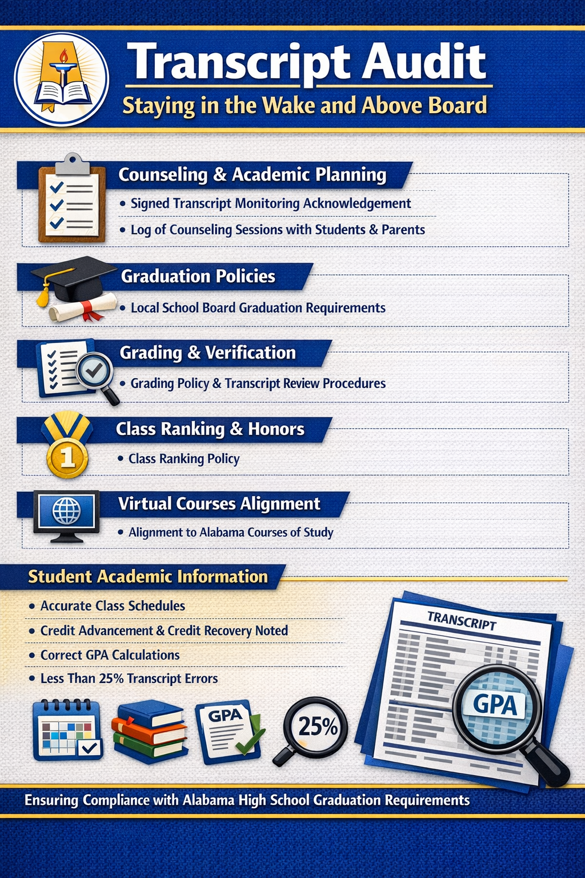
Transcript Audit
Alabama Public Charter School Commission | Professional Development Training

Slide 67
Student Handbook
✅ School Mission Statement A clear statement of the school’s purpose and priorities.
✅ School Contact Information Main phone, address, email, and key administrative contacts.
✅ School Calendar Dates the school year begins and ends, holidays, and other scheduled breaks.
✅ Attendance Policy How attendance is taken, requirements for excused vs. unexcused absences, tardies, and any legal attendance mandates.
✅ Student Discipline Policy Rules of conduct, consequences for misbehavior, suspension/expulsion procedures, and due-process information.
✅ Student Rights & Responsibilities Expectations for student behavior and protections (e.g., academic, behavioral, safety rights).
Alabama Public Charter School Commission | Professional Development Training

Slide 68
Student Handbook
📎 Additional Considerations (Best Practice)
🟡 Non-discrimination policies (aligned with Code § 16-6F-5) — schools must not discriminate in enrollment or treatment of students. 🟡 FERPA/Privacy rights and information on how student records are managed. 🟡 Bullying prevention and reporting procedures. 🟡 Dress code expectations. 🟡 Technology/Internet use guidelines. 🟡 Health and safety procedures (emergencies, medication, illness reporting).
Alabama Public Charter School Commission | Professional Development Training

Slide 69
ACT 2024-34
📜 Summary of Alabama Act 2024-34
Act 2024-34 was signed into law in 2024 and took effect on October 1, 2024
What the Law Does
Act 2024-34 prohibits state agencies, public colleges and universities, and local boards of education from operating, sponsoring, or funding Diversity, Equity & Inclusion (DEI) offices or programs that advocate certain prohibited concepts.
It also bars requiring students, employees, or contractors to attend or participate in programs that promote or require agreement with specific ideas defined as “divisive concepts.”
Alabama Public Charter School Commission | Professional Development Training

Slide 70
School Calendar
Be sure to align with your charter contract!!!
3. Holidays & Breaks
Include all major closures:
Labor Day
Thanksgiving Break
Winter/Christmas Break
Martin Luther King Jr. Day
Spring Break
Memorial Day (if school is in session)
You may align loosely with local districts for family convenience, but charters can set independent calendars.
4. Professional Development (PD) Days:
Teacher Workdays
In-service Days
Staff Training Days
1. Required Instructional Time
✅ Minimum Instructional Days
✅ Instructional Hours
2. Start and End Dates
First day of school (students)
Last day of school (students)
Teacher pre-planning days
Teacher post-planning days
Charter schools often choose:
Earlier start dates (early August)
Flexible breaks
Extended year models
Alabama Public Charter School Commission | Professional Development Training

Slide 71
School Calendar
Be sure to align with your charter contract!!!
5. Assessment Windows
State assessment windows (e.g., ACAP)
Benchmark testing periods
ACT testing dates (if applicable)
Progress report/report card dates
Even if windows shift slightly, include approximate weeks.
6. Early Release / Late Start Days
If used, clearly identify:
Monthly early dismissal days
Late start
Days for staff collaboration.
7. Grading Periods
Quarters or trimesters
Semester end dates
Report card distribution dates
Progress report checkpoints
8. Special Events
Open House
Parent-Teacher Conferences
Charter renewal site visits (if known year)
STEM Night / Arts Showcase
Alabama Public Charter School Commission | Professional Development Training

Slide 72
School Calendar
Be sure to align with your charter contract!!!
9. Weather Make-Up Plan
Charter schools should clearly state:
Designated weather make-up days
Use of remote learning (if approved)
How days will be recovered
Alabama schools typically build in:
3–5 make-up days OR
Extra instructional minutes built into daily schedule
Alabama Public Charter School Commission | Professional Development Training

Slide 73

Applause

