Slide 1

Professional Development Training
March 9–10, 2026
Charter School Leadership Training | Montgomery, Alabama
Alabama Public Charter School Commission

Slide 2
APCSC & ALSDE Roles
Alabama Public Charter School Commission | Professional Development Training

Slide 3
APCSC & ALSDE
Alabama Public Charter School Commission is the primary oversight for charter schools.
Responsibilities of the Authorizer:
  Approve or deny charter applications.
  Negotiate and execute the charter contract.
  Monitor performance (academic, financial, operational).
  Conduct site visits and review data.
  Place schools on corrective action if performance is inadequate.
  Renew, non-renew, or revoke charters based on performance and compliance.
The authorizer acts as the primary accountability body, ensuring the school meets the performance standards outlined in its charter contract.
The Alabama State Department of Education (ALSDE) plays a broader regulatory role.
Responsibilities of the State Department:
  Ensure support and administration of state requirements, including federal and special education, and civil rights laws.
  Manage state assessment and accountability systems.
  Allocate state and federal funding.
  Provide oversight to authorizers to ensure they are fulfilling their duties appropriately.
  Collect statewide data for reporting and public transparency.
While the authorizer and the Department both directly monitor the school’s performance, the authorizer is responsible for legal compliance so all information must come to the authorizer.
Alabama Public Charter School Commission | Professional Development Training

Slide 4
Performance Framework Alignment
Category | What the School Reports to Authorizer | What Ultimately Goes to ALSDE
Academics | State assessment results, growth data, subgroup data, attendance, graduation (if applicable) | Included in state accountability system (reported via authorizer/local system)
Finance | Annual budget, financial statements, independent audit, GAAP compliance | Financial compliance data monitored through authorizer reporting
Operations | Enrollment counts, attendance data, discipline data, safety compliance | Enrollment/attendance data reported through local system to ALSDE
Governance | Board minutes, policies, transparency assurances, annual performance report | Renewal/non-renewal decisions reported to ALSDE by authorizer
Alabama Public Charter School Commission | Professional Development Training

Slide 5
Division of Roles
Function | Charter School | APCSC | ALSDE
Academic Oversight | Implements instruction; administers state assessments; provides academic data | Reviews performance framework indicators; evaluates proficiency, growth, and subgroup performance | Publishes statewide accountability results
Financial Oversight | Develops budget; submits financial reports; completes annual audit | Reviews fiscal health, audit findings, and sustainability | Oversees Foundation Program calculations and compliance with state/federal funding rules
Operations Oversight | Ensures operational compliance (enrollment capacity, attendance, health & safety, legal compliance); submits required operational data | Monitors operational performance; conducts site visits; ensures compliance with charter contract terms | Ensures statewide regulatory compliance
Alabama Public Charter School Commission | Professional Development Training

Slide 6
Division of Roles
Function | Charter School | APCSC | ALSDE
Governance & Compliance | Governing board ensures transparency, Open Meetings compliance, and adherence to charter contract | Evaluates board performance and stewardship; enforces corrective actions if needed | Oversees authorizers and enforces statewide charter law compliance
Renewal & Revocation | Submits renewal documentation and performance evidence | Approves, renews, non-renews, or revokes charter | Receives formal notification of authorizer decisions; may intervene if authorizer fails to comply
Authorizer Accountability | N/A | Submits annual report | Oversees authorizer effectiveness and may revoke authorizing authority for LEAs
Alabama Public Charter School Commission | Professional Development Training

Slide 7
RACI Model
The RACI model is a responsibility assignment framework used in project management to clarify roles and decision-making. It ensures everyone knows who does the work, who approves it, who provides input, and who stays informed.
RACI stands for:
R – Responsible
A – Accountable
C – Consulted
I – Informed
Alabama Public Charter School Commission | Professional Development Training

Slide 8
Charter Authorization & Contract Approval
The APCSC is an eligible authorizer with full chartering power who inform ALDSE about applications and consult with ALSDE on compliance with laws.
Function | APCSC | ALSDE
Approve or deny applications | Accountable & Responsible | Informed
Execute charter contract with school governing board | Accountable & Responsible | Informed
Ensure application complies with state and federal law | Accountable & Responsible | Consulted
Alabama Public Charter School Commission | Professional Development Training

Slide 9
Oversight & Performance Monitoring
APCSC monitors charter schools and contracts. ALSDE oversees the effectiveness of authorizers.
Function | APCSC | ALSDE
Ongoing monitoring of charter performances, finances, & governance | Accountable & Responsible | Informed
Enforce charter contract terms | Accountable & Responsible | Informed
Conduct authorizer effectiveness oversight | Consulted | Accountable & Responsible
Alabama Public Charter School Commission | Professional Development Training

Slide 10
Compliance & Reporting Requirements
APCSC oversees that compliance requirements are met and collects information to create an annual report. Reports are submitted to the ALSDE.
Function | APCSC | ALSDE
Ensure school meets federal health, safety, & civil rights obligations | Accountable & Responsible | Consulted
Collect annual reports from charter schools | Accountable & Responsible | Informed
Receive authorized reports summarizing charter school performance | Consulted | Accountable & Responsible
Alabama Public Charter School Commission | Professional Development Training

Slide 11
Renewal, Non-Renewal, or Revocation
Decision belongs to APCSC. The decision to renew, non-renew, or revoke is reported to the ALSDE.
Function | APCSC | ALSDE
Decide renewal of charter contract | Accountable & Responsible | Informed
Decide revocation or closure | Accountable & Responsible | Informed
Provide guidance on closure procedures and funding impact | Accountable & Responsible | Accountable & Responsible
Alabama Public Charter School Commission | Professional Development Training

Slide 12
Funding Distribution & Accountability Controls
ALSDE distributes and withholds funds. APCSC monitors financial performance of charter schools.
Function | APCSC | ALSDE
Monitor financial performance | Accountable & Responsible | Consulted
Withhold funds if required reports are not submitted | Consulted & Informed | Accountable & Responsible
Ensure state and federal funding is properly allocated | Informed | Accountable & Responsible
Alabama Public Charter School Commission | Professional Development Training

Slide 13
Policy Guidance, Rules, & Statewide Support
ALDSE informs APCSC of polices, rules, laws, and guidelines. APCSC establishes their own rules and guidelines for charter schools.
Function | APCSC | ALSDE
Establish APCSC internal rules and bylaws | Accountable & Responsible | Informed
Provide statewide charter school operational guidelines | Consulted | Accountable & Responsible
Maintain administrative code and regulatory framework | Informed | Accountable & Responsible
Alabama Public Charter School Commission | Professional Development Training

Slide 14
Data, Accountability Systems, and State Reporting
APCSC provides data to ALSDE. ALSDE maintains the statewide data accountability infrastructure.
Function | APCSC | ALSDE
Provide school performance data to ALSDE | Responsible | Informed
Maintain statewide school accountability & reporting systems | Informed | Accountable & Responsible
Include charter schools in state assessment frameworks | Consulted | Accountable & Responsible
Alabama Public Charter School Commission | Professional Development Training

Slide 15
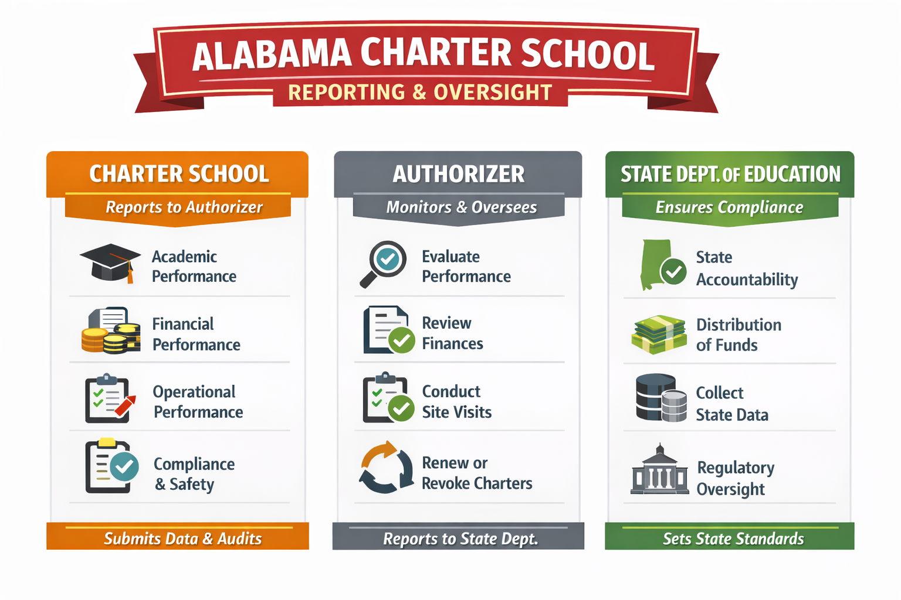
Reporting Requirements
The charter school reports primarily to its authorizer.
The authorizer reports to the ALSDE.
Alabama Public Charter School Commission | Professional Development Training

Slide 16
Charter Contract
Alabama Public Charter School Commission | Professional Development Training

Slide 17
Purpose of the Charter Contract
Required under the Alabama School Choice and Student Opportunity Act (Act 2015-3)
Establishes a fixed-term, renewable agreement
Defines:
  Roles
  Responsibilities
  Performance Expectations
Agreement between authorizer and the charter school governing board
Alabama Public Charter School Commission | Professional Development Training

Slide 18
Pre-Opening Requirements
Facility secured and approved
Health & safety permits obtained
Certificate of Occupancy
Governing Board established
Enrollment targets
Staff background checks complete
Financial capacity & systems in place
Pre-opening site visit by Commission
Failure to meet pre-opening requirement deadlines may result in a delay of school opening.
Alabama Public Charter School Commission | Professional Development Training

Slide 19
Governance Structure
Must be a 501(c)(3) non-profit organization
Independent Governing Board established as described in the application
At least 20% board members must be parents
Members are subject to the State Ethics Law (Alabama Code §16-6F-9)
Subject to Alabama Open Meetings Act
Alabama Public Charter School Commission | Professional Development Training

Slide 20
General Operational Requirement
Schools must operate at all times in accordance with all applicable laws, their contract, and Commission policies.
Must operate as a public school
Nonsectarian
Non-discrimination required
Maintain records and transparency
Maintain inventories of all capital assets costing more than $5,000
Transportation must be consistent with proposed plan in approved application
Must comply with applicable federal laws, rules and regulations regarding the qualification of teachers and staff.
Alabama Public Charter School Commission | Professional Development Training

Slide 21
General Operational Requirement
Schools may enter into contracts or other agreements with as school district, educational service, or other entities.
If the School intends to contract with an education service provider for substantial education services, management services, or both types of services, the School shall provide to the Commission all of the following at least 90 days before the effective date of the proposed contract:
a. Evidence of the education service provider’s success in serving student populations similar to the targeted population, including demonstrated academic achievement as well as successful management of nonacademic school functions, if applicable.
b. A draft agreement setting forth the proposed duration of the service contract; roles and responsibilities of the Governing Board, the School staff, and the education service provider; scope of services and resources to be provided by the education service provider; performance evaluation measures and timelines; compensation structure, including clear identification of all fees to be paid to the education service provider; methods of contract oversight and enforcement; investment disclosure; and conditions for renewal and termination of the contract.
c. Disclosure and explanation of any existing or potential conflicts of interest between the School or the Governing Board and the education service provider or any affiliated business entities.
Alabama Public Charter School Commission | Professional Development Training

Slide 22
General Operational Requirement
Transaction with Affiliates
The School shall not, directly or indirectly, enter into or permit to exist any transaction (including the purchase, sale, lease, or exchange of any property or the rendering of any service) with any affiliate of the School, any member past or present of the Governing Board, or any past or present employee of the School (except in their employment capacity), or any family member of the foregoing individuals, unless:
  The terms of the transaction do not violate the Schools’ Code of Ethics and Conflict of Interest Policy or the terms of this Contract.
  The terms of such transaction (considering all the facts and circumstances) are no less favorable to the School than those that could be obtained at the time from a person that is not such an affiliate, member, employee, or an individual related thereto.
  The involved individual recuses him or herself from all Governing Board discussions and does not vote on or decide any matters related to such transaction.
  The Governing Board discloses any conflicts and operates in accordance with a conflict of interest policy that has been approved by the Commission.
Alabama Public Charter School Commission | Professional Development Training

Slide 23
Enrollment
Open enrollment
Capacity goals are made annually and must follow enrollment plan, which is reviewed annually
Cannot exceed facility limits
Student records maintained like traditional public schools
Use state student information system
Alabama Public Charter School Commission | Professional Development Training

Slide 24
Educational Program & Accountability
Must implement approved educational design
Required to participate in state testing
Schools may not charge tuition and may only charge such fees as may be imposed on other students attending regular public schools in the state. Each fee must be approved by the Governing Board.
Must provide services for Special Populations
  English Learners
  Students with disabilities (IDEA, ADA, Section 504 compliance)
  Must provide legally required services
  IEP compliance required
Alabama Public Charter School Commission | Professional Development Training

Slide 25
Financial Accountability
Financial accounting information (payroll, budgeting, general fixed assets, etc.) must be reported to the State Department of Education.
Annual independent audit required
Monthly financial reports posted publicly
Budgets must be submitted annually. The Commission can require revision of budgets.
Funds kept in approved public depository (Security for Alabama Funds Enhancement Act)
Alabama Public Charter School Commission | Professional Development Training

Slide 26
Facility Requirements
ADA Compliant
Meet fire, health, and safety codes
Approved physical plant
Change of location requires Commission approval
Subject to inspection
Alabama Public Charter School Commission | Professional Development Training

Slide 27
Employment Requirements
Employees are not state employees
The Governing Boad must vote if employees will participate in The Public Education Employees’ Health Insurance Plan and the Teacher’s Retirement System. The deciding vote is permanent.
Background check required
Must comply with:
  Alabama Child Protection Act
  Immigration Laws (E-Verify)
Alabama Public Charter School Commission | Professional Development Training

Slide 28
Insurance & Legal Protections
Required insurance coverage:
  Property Insurance
  General Liability Insurance
  Workers’ Compensation Insurance
  Unemployment Compensation Insurance
  Errors and Omission Insurance
  Motor Vehicle Insurance (if applicable)
  Any other insurance intended to cover the Governing Board, school, or employees.
State of Alabama not liable to school debts
Cannot bind state or Commission financially
Alabama Public Charter School Commission | Professional Development Training

Slide 29
Oversight & Accountability
The performance provisions of this contract are based on a performance framework that clearly sets forth the academic financial, and operational performance indicators, measures, and metrics that will guide the Commission’s evaluations of each public charter school. In addition to state and federal accountability standards, the performance framework should include specific provisions, indicators, measures, and metrics for:
Student academic proficiency, which includes, but is not limited to, performance on state standardized assessments.
Student academic growth, which includes, but is not limited to, performance on state standardized assessments.
Achievement gaps in both proficiency and growth between major student subgroups.
Attendance.
Recurrent enrollment from year to year.
Postsecondary readiness for high school.
Financial performance and sustainability.
Governing Board performance and stewardship, including compliance with all applicable laws, regulations, and terms of the charter contract.
The performance framework requires the disaggregation of all student performance data by major student subgroups (including gender, race, poverty status, special education status, English learner status, and gifted status).
Alabama Public Charter School Commission | Professional Development Training

Slide 30
Miscellaneous Provisions
School records must be maintained in accordance with all applicable state and federal document and record retention requirements
The education records of students enrolled in a School are governed by the requirements of the Family Educational Rights and Privacy Act (“FERPA”), 20 U.S.C. §1232g, and its corresponding regulations.
Schools must safeguard personally identifiable information from education records in their possession by developing and adhering to a Data Governance Policy that safeguards against unauthorized access or disclosure of such records.
Alabama Public Charter School Commission | Professional Development Training

Slide 31
Attachment Overview
These are considered supporting documents that define how the school functions. While the earlier sections of the contract describe expectations broadly, these attachments operationalize those expectations.
  Pre-Opening Conditions & Deadlines
  Educational Program Commitments
  Performance Framework
  Governance & Organization Documents
  Financial & Operational Assurances
Alabama Public Charter School Commission | Professional Development Training

Slide 32
Charter Contracts
Charter contract is a performance-based agreement
Provides autonomy with accountability
Requires strong governance and financial oversight
Commission maintains oversight and has the regulatory authority to:
  Monitor academic, financial, and operational performance
  Request & Review records
  Visit schools (announced or unannounced)
  Require corrective action plans
  Revoke or non-renew charter
Alabama Public Charter School Commission | Professional Development Training

Slide 33

Questions and Discussion
We welcome your questions and feedback.

Slide 34
University Charter School
APCSC Conference 2026
Education Service Provider Presentation
March 9-10, 2026
“You can DREAM, create, design, and BUILD the most wonderful place in the world, but it requires PEOPLE to make the dream a REALITY.”
-Walt Disney

Slide 35




UCS By the Numbers
Year 8 of Operation PK-12 | Total Number of Students | Total Number of Employees

Slide 36
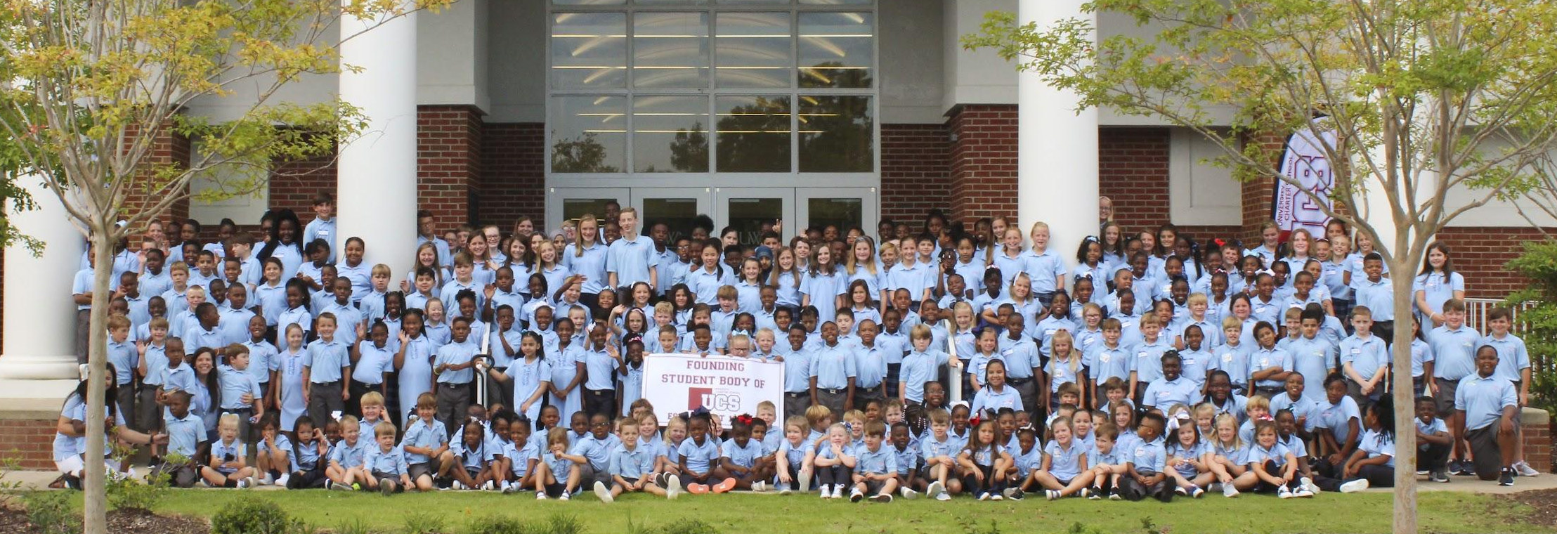
Founding Day: August 13, 2018
On Founding Day, UCS opened its doors to 306 students in grades PK-8. It was a historic day in Sumter County.

Slide 37
Purpose of UCS
Incubate and Replicate a High Quality, Innovative School Model
Ignite Community Transformation
Inspire Students to Look for LOCAL OPPORTUNITY
Improve Quality of Life
Laboratory for Best Practices
Economic and Workforce Development
Business and Industry Recruitment
Create a Climate of Inclusivity
Inspire Community Partnerships
Notes:
Speak specifically to the things that will be seen on the tour.
9:30-9:37 - Egbert (Teacher Choice / CKLA)
9:37-9:45 - 3rd Grade Alsabrook (Teacher Choice / CKLA multi-senesory?)
9:45-9:50 - MS Band Auditorium
9:50-9:55 - Tatum PreK STEM
9:55-10:05 - Lunch space / UWA COE Discussion of space constraints and shared space collaboration and accessibility
10:05-10:10 - Cunningham K
10:15-10:25 - Allen 10B ELA
10:30-10:40 - Mayben IMC Program overview
10:45-10:55 - BrewCS (order pick up & WBL Regional Best Practice Recognition) restroom break
10:55-11:05 - Freeman Senior Environmental Science

Slide 38

Free-Reduced
Lunch
46%
English Language Learners
3%
Special Education Students
13%
Gifted and Talented
12.5%

Slide 39
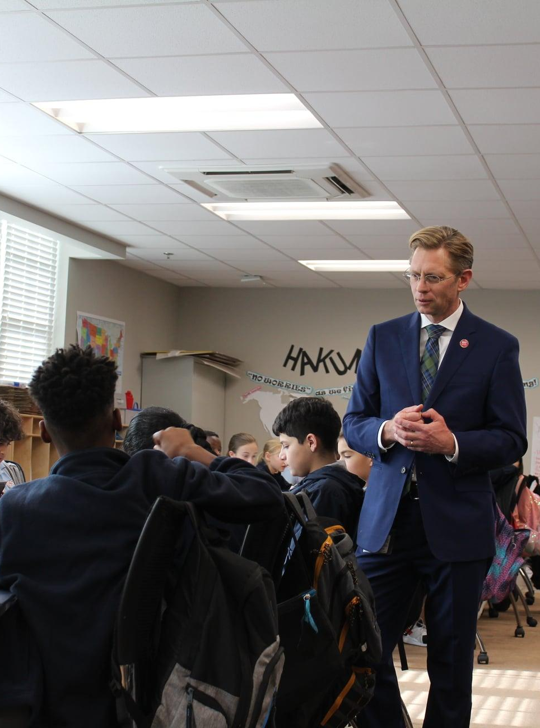




Highlights
and
Accomplishments
ACAP Data Celebrations
Above state average across all tested grades and content areas
AL Reading Initiative Science of Reading
Spotlight School Designation
2022-2023 and 2023-2024 Academic Year
National Blue Ribbon Schools of Excellence
Designated a Lighthouse School in 2024
Character.org National School of Character
One of 2 schools in Alabama
Awarded in May 2023
Cognia Accreditation
1st charter school in Alabama
Awarded during Year 2 of operation, renewed in 2025
A-Rated District on ALSDE Report Card
First charter school in AL to receive an A rating.

Slide 40


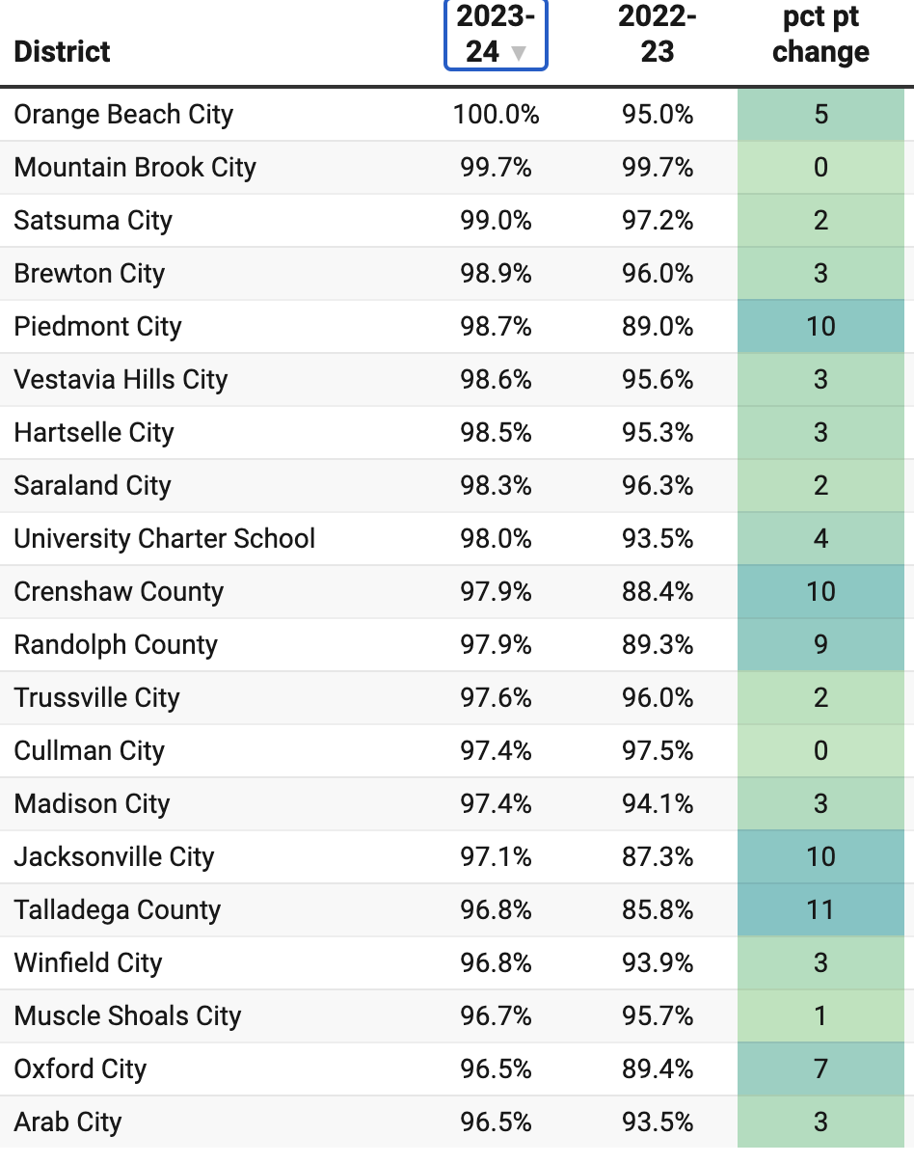



Report Card Score for 23-24

Slide 41

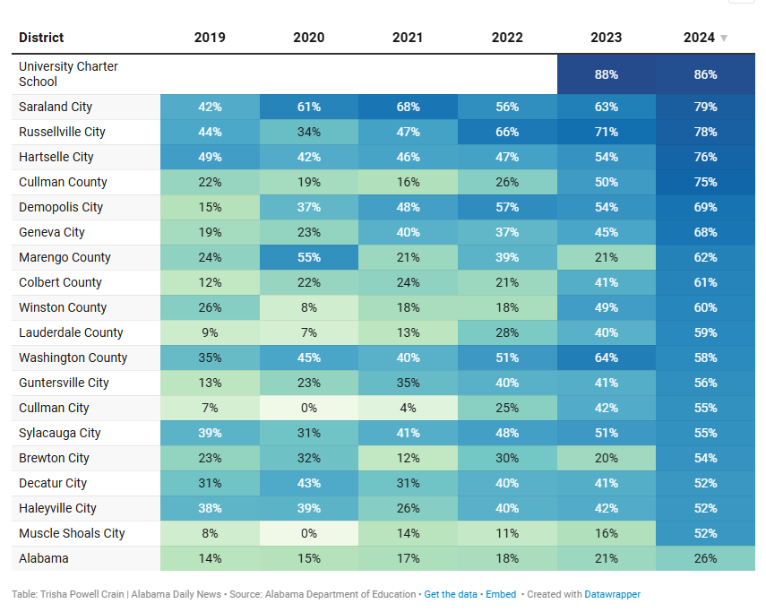
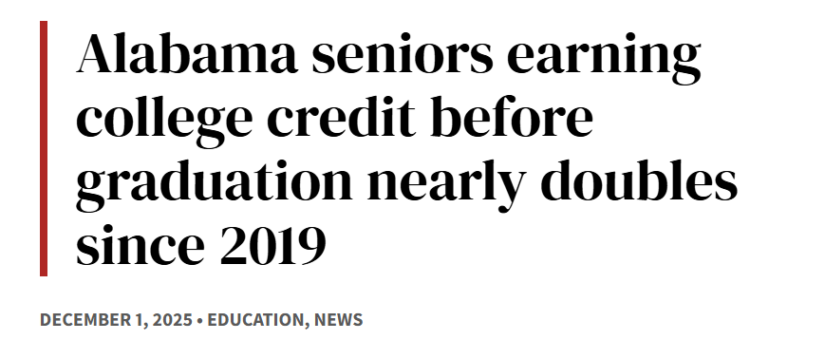
UCS ranks #1 of ALL schools in Alabama!

Slide 42

University Place-based Regional Education Partnership

Slide 43


Slide 44
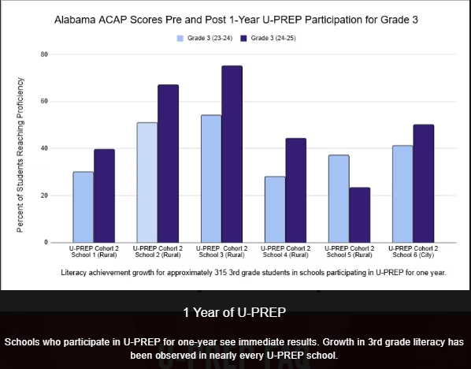

Slide 45
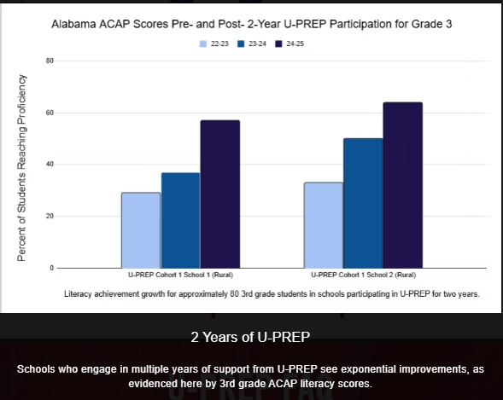

Slide 46

Our Partnership Outcomes
10% average increase
in one year
17% average increase
over two years
30% average increase
over three years
Outcomes = percentage of students reaching benchmark compared to the prior year.

Slide 47
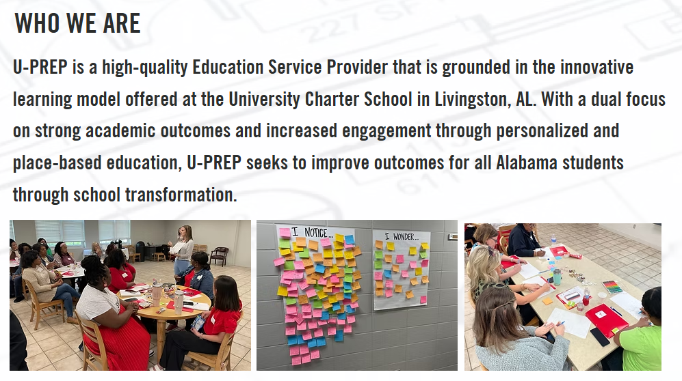

Slide 48
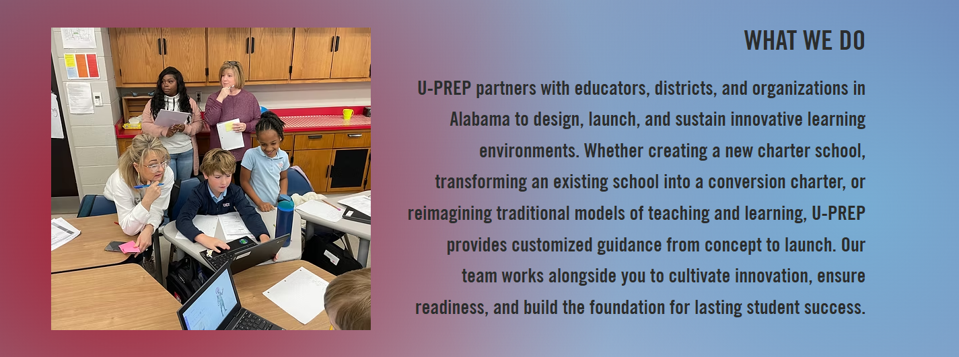

Slide 49
Three Models of Support
REALIZE | REIMAGINE | REIGNITE
Support for start-up models. | Support for conversion models. | Support for traditional school innovation.
Charter application support. Grant application support. Year 0 supports (pre-opening conditions, recruitment and training of talent, community outreach, school identity development and planning). Year 1+ continuation services support for leaders and teachers | Conversion application support with authorizing entity. Year 0 supports (pre-opening conditions, recruitment and training of talent, community outreach, school identity development and planning). Continuation services for Year 1+ to support leaders and teachers. | Rethinking and reevaluating the approach to teaching and learning. Leveraging innovation waivers and forward-thinking practices. Strengths and needs inventory. Job-embedded professional learning, coaching, and support to innovative identified areas of opportunity.

Slide 50


Slide 51


Multi-year U-PREP partner
Newest multi-year conversion charter partner.

Slide 52


Slide 53

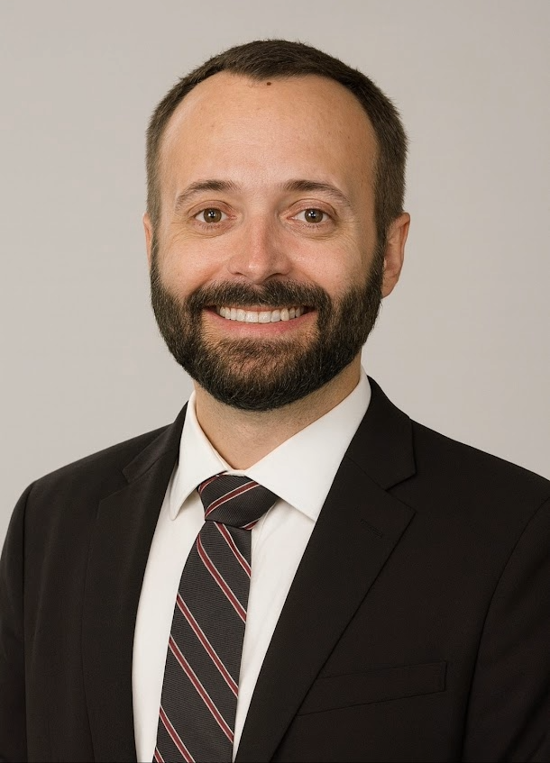
Phone
205.575.3297
Email
uprep@universitycharterschool.org
mjohnson@universitycharterschool.org
Dr. Matt Johnson
Chief Innovation Officer
University Charter School // U-PREP
Learn more at
uprep.info

